Slide 1
Module II
Radiation protection in NPPs
Presenter’s name
Presenter’s title
Presenter’s email

Slide 2
Contents
Introduction to radiation
Interaction of radiation with matter
Radiation detection
Dosimetric quantities
Biological effects of radiation

Slide 3
Contents (cont’d)
External radiation exposure
Internal radiation exposure
Radiation protection regulations
Radiation protection in nuclear installations
Protection of the environment

Slide 4
Introduction to radiation

Slide 5
Learning objectives
Define ionizing radiation
Explain the main properties of various ionizing radiations
List the harmful health effects observed in ionizing radiation use
Describe the role of the ICRU
Describe the role of the ICRP

Slide 6
Electromagnetic (EM) radiation
Energy travelling through space
Light is EM radiation that can be perceived by human senses
Other EM radiation cannot be perceived by human senses:
  Radio waves
  Microwaves
  Infrared radiation
  X-rays, etc.
Notes:
Radiation is a physical phenomenon where a body gives off energy and this energy travels through space until absorbed by another body. Typical examples of radiation which can be perceived by the human senses are sound and light. Sound is a mechanical wave which can only spread through matter (and is of no further interest to us), unlike light, which travels most freely through completely empty space (a vacuum).

Slide 7
EM radiation (cont’d)
Minimum energy packet of EM radiation is called a photon
Energy of photon is inversely proportional to wavelength
Energy of photons of visible light is ~2 eV
Notes:
The energy carried by electromagnetic radiation through space cannot be broken down into arbitrarily small parts. As it turns out, there is a minimum energy packet of electromagnetic radiation which cannot be further separated into smaller amounts of energy. Such a packet of electromagnetic radiation is called a photon. The energy of a photon is inversely proportional to the wavelength of the radiation. The energy of photons of visible light is around 2 eV, while photons contained in radiation with a wavelength shorter or longer than visible light have correspondingly higher or lower energy, respectively.

Slide 8
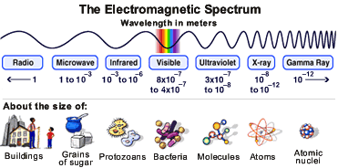

Slide 9
Ionizing EM radiation
EM radiation with an energy greater than the binding energy of electrons in atoms (12 eV)
Capable of removing electrons from atoms
Ionizing radiation produces electron-ion pairs or ion pairs
Includes:
  Ultraviolet (partly)
  X-rays
  Gamma radiation
Notes:
Of interest particularly is radiation which has a wavelength shorter than 100 nm or an energy higher than 12 eV. Since this energy is greater than the binding energy of electrons in the atom, electromagnetic radiation with a wavelength below 100 nm is capable of removing electrons from the atoms of the matter it is moving through. Radiation passing through matter with a large enough photon energy produces electron-ion pairs or ion pairs. This phenomenon is called ionization and the associated radiation is ionizing radiation. Within the electromagnetic spectrum, ionizing radiation includes ultraviolet (partly), X and gamma radiation. Although these types of radiation differ from each other in energy and origin, the mechanisms of their interaction with matter are practically identical and will from now on be collectively considered as gamma radiation, because this is the type of electromagnetic radiation we will most often deal with.

Slide 10
Other types of ionizing radiation
Particles with mass
Atom-sized or smaller
Originate from radioactive decay, nuclear fission or accelerators
Energies ~MeV
  Exception: neutrons are ionizing radiation even with negligible kinetic energy
Notes:
Of interest particularly is radiation which has a wavelength shorter than 100 nm or an energy higher than 12 eV. Since this energy is greater than the binding energy of electrons in the atom, electromagnetic radiation with a wavelength below 100 nm is capable of removing electrons from the atoms of the matter it is moving through. Radiation passing through matter with a large enough photon energy produces electron-ion pairs or ion pairs. This phenomenon is called ionization and the associated radiation is ionizing radiation. Within the electromagnetic spectrum, ionizing radiation includes ultraviolet (partly), X and gamma radiation. Although these types of radiation differ from each other in energy and origin, the mechanisms of their interaction with matter are practically identical and will from now on be collectively considered as gamma radiation, because this is the type of electromagnetic radiation we will most often deal with.

Slide 11
Radiation characteristics
name (symbol) | characteristic | mass | charge | typical sources | penetration depth
Alpha (α) | ⁴He nuclei | ~4 u | +2 | heavy nuclei | air: ~cm sheet of paper
beta (β⁻) (β⁺) | electrons positrons | 0.00055 u | –1 +1 | fission and activation products | air: ~m Al: ~mm
gamma (γ) | EM radiation | – | 0 | almost all radionuclides | Pb: ~100 mm water: ~m
neutron (n) | nucleon | ~1 u | 0 | reactor | paraffin: ~m water: ~10 m
Notes:
In the context of radiation protection, our interest will focus almost exclusively on ionizing radiation. For simplicity’s sake, we will often drop the adjective “ionizing” and refer to radiation only. The most important types of radiation encountered in nuclear technology and their main characteristics are given here.

Slide 12
Natural sources of ionizing radiation
Present on Earth since creation
Origin and intensity are not influenced by humans
Three families:
  Long-lived radionuclides and their progeny
  Cosmic radiation
  Cosmogenic radionuclides
Notes:
Radioactivity and ionizing radiation have been present on Earth since its very creation. All sources of radiation that occur naturally without their origin or intensity being influenced by humans in any way are called natural sources of radiation. They are grouped into three families:
very long-lived radionuclides and their progeny,
cosmic radiation,
cosmogenic radionuclides

Slide 13
Long-lived radionuclides and their progeny
Have not decayed since Earth’s formation
  Thorium-232 (half-life: 1.4·10¹⁰ years);
  Uranium-235 (half-life: 7·10⁸ years);
  Uranium-238 (half-life: 4.5·10⁹ years);
  Potassium-40 (half-life: 1.3·10⁹ years).
Daughter products (progeny) have shorter half-lives, but are generated continuously and are present in nature
  Radium-226 (half-life 1600 years)
  Radon-222 (half-life: 3.8 days)
Notes:
Very long-lived radionuclides have such a long half-life that they have not decayed away since the beginning of the Earth. They include three nuclides from the end of the periodic table (²³²Th, t_{1/2} = 1.4·10¹⁰ years, ²³⁵U, t_{1/2} = 7·10⁸ years, ²³⁸U, t_{1/2} = 4.5·10⁹ years) and their radioactive daughter products which form radioactive chains ending in stable lead. These daughter products have short enough half-lives to have decayed long since the origin of the Earth; however, being continuously produced by the decay of the long-lived chain originator, radioactive equilibrium between them is maintained. Within these natural radioactive chains, nuclides of special importance for radiation protection include ²²⁶Ra (t_{1/2} = 1600 years) and its daughter product, the noble gas ²²²Rn (t_{1/2} = 3.8 days).
There are also a few very long-lived nuclides which are not members of the natural radioactive chains from the end of the periodic table. The key nuclide of this kind is ⁴⁰K (t_{1/2} = 1.3·10⁹ years).

Slide 14
Cosmic radiation
Ionizing radiation coming from outer space
Mostly high-energy protons (~GeV)
Triggers nuclear reactions in upper atmosphere producing gamma rays, neutrons, muons
Doses comparable with doses from other natural sources
Intensity increases with altitude
  Additional exposure during transatlantic flight (7 hours) comparable to a weekly dose at sea level
Notes:
Cosmic radiation is ionizing radiation which comes from space. Its source is so far unknown. It largely consists of high-energy (~GeV) protons that trigger nuclear reactions in the upper layers of the atmosphere, producing other ionizing particles (gamma rays, neutrons) which reach the Earth’s surface. Cosmic radiation makes a significant contribution to natural background radiation or natural human exposure to radiation. The intensity of cosmic radiation increases with altitude; during a transatlantic flight we will receive an additional dose comparable to a weekly dose of natural radiation on ground,

Slide 15
Cosmogenic radionuclides
Products of some nuclear reactions with cosmic radiation
Shorter half-lives, but are formed continuously
Three important cosmogenic radionuclides are:
  Hydrogen-3 (tritium) (half-life: 12.3 years)
  Beryllium-7 (half-life: 53 days)
  Carbon-14 (half-life: 5760 years)
Notes:
Cosmic radiation is also the cause of the formation of cosmogenic radionuclides. Though their half-lives are relatively short, they are continuously formed by nuclear reactions which are triggered by cosmic radiation in the atmosphere. The most important cosmogenic nuclides are: ³H (t_{1/2} = 12.3 years), ⁷Be (t_{1/2} = 53 days) and ¹⁴C (t_{1/2} = 5760 years).

Slide 16
Artificial sources of radiation
The major sources of man-made radiation and artificial radionuclides are operating nuclear reactors
Other sources include:
  X-ray devices
  Particle accelerators
  Materials with a technologically enhanced concentration of natural radionuclides
Notes:
Artificial sources of radiation are sources made by man (i.e. anthropogenic). They include:
X-ray devices,
particle accelerators,
artificial radionuclides,
nuclear reactors,
materials with a technologically enhanced concentration of natural radionuclides
In nuclear technology, the major sources of radiation are nuclear reactors, which are simultaneously sources of artificial radionuclides.

Slide 17
Exercise #1
For the following sources of radiation, identify whether the source is natural/artificial and whether the radiation is ionizing/nonionizing:
Cell phone
Microwave oven
Television set
Radioactive level gauge in petroleum refinery
Uranium ore in the ground
Uranium mine
Granite rock
Hospital X-ray machine
Cobalt therapy machine
400 kV power line
Electric shaver
Kitchen blender
Sun

Slide 18
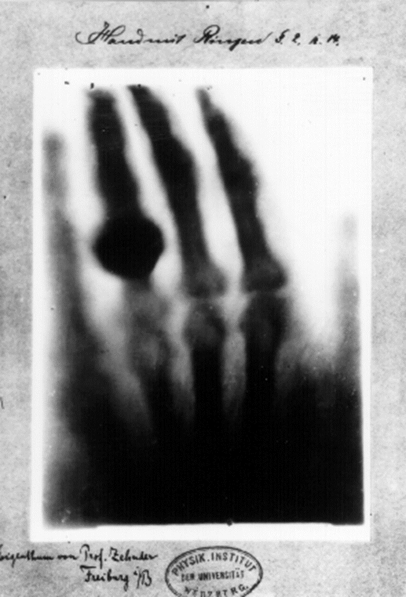
Development of radiation science
Radiation has been part of the natural world since the beginning of time and humanity has always been exposed to radiation
In 1895, Wilhelm Conrad Röntgen
discovered X-rays
In 1896, Henry Becquerel discovered
radioactivity
X-ray sources, then radioactive sources,
soon found applications in medicine,
physics and chemistry
X-ray of Mrs Röntgen’s hand
Notes:
Radiation has been part of the natural world ever since the birth of the universe, just as humanity has always been exposed to various forms of natural radiation throughout its evolution. We were not aware of ionizing radiation, until two major discoveries were made in late 19th century. First, on 8 November 1895, Wilhelm Conrad Röntgen discovered penetrating rays which he called X-rays (nowadays they are also called roentgen rays). Only a few months later (1 March 1896), Henry Becquerel discovered a phenomenon which was later named radioactivity by Marie Curie.
Soon after both discoveries, X-rays in particular were found to have practical value (e.g. to take pictures of the inside of the human body), so X-ray devices and radioactive substances started being used in physics, chemistry and medicine. In those pioneering times, users were not aware that excessive exposure to radiation has serious biological consequences. Nor did they have any accurate instruments for measuring the intensity of radiation.

Slide 19
Early evidence of harm from radiation
First users of X-rays suffered from:
  Erythema (abnormal skin redness)
  Oedema (water accumulation in tissues)
  Epilation (hair loss)
By 1911, 94 cases of tumours were attributed to exposure to X-rays
In 1922, an estimate was published that around 100 radiologists had died from radiation induced cancers
Notes:
The earliest use of radiation was very soon followed by cases of damage from intensive exposure to sources of radiation. In 1896, it was found that exposure to X-rays may cause erythema (abnormal skin redness), oedema (water accumulation in tissues) and epilation (hair loss). In this period, X-ray tubes were calibrated simply on the basis of the erythema caused on a hand exposed to X-radiation by the operator.
Soon after, carcinogenic or cancer-inducing effects of radiation were also observed. By 1911, 94 cases of tumours caused by X-radiation were reported, 50 of them among radiologists (doctors specialized in the use of radiation for medical purposes). In 1922, an estimate was published that 100 radiologists had died from radiation-induced cancer.

Slide 20
Early evidence of harm from radiation (cont’d)
Soon after, it was discovered that incidence of leukaemia was much higher in radiologists than other physicians
Marie Curie died from leukaemia in 1934, after suffering for years from radiation-caused chronic illnesses. At the time, her condition and death were not attributed to her work with radium
It was much later that the danger of exposure to radioactive materials was recognized
Notes:
Somewhat later, it was discovered that leukaemia (also called cancer of the blood or bone marrow) is much more frequent in radiologists than other physicians. Marie Curie who worked with radioactive materials died of leukaemia in 1934 aged 67 years.

Slide 21
Dawn of radiation protection
Once harmful effects of radiation were understood, recommendations were made to reduce excessive exposure
First recommendations were intended to prevent acute effects
Additional evidence in 1920s and 1930s revealed a connection with increased cancer incidence
  Radium Girls suffered from anaemia, bone fractures and necrosis of the jaw, and many developed cancer
  Uranium miners suffered from increased incidence of lung cancer
Notes:
Along with its obvious benefits, the use of radiation was thus accompanied by incontrovertible proof of its harmful effects. Relatively early on, this gave rise to the first recommendations for reducing excessive exposure to radiation, which eventually developed into a special scientific discipline – radiation protection.
The first limits on exposure to radiation were intended to prevent acute effects such as skin lesions which occur after high exposure to radiation. Later, limits were introduced to prevent more insidious effects causing harm in the long term, such as cancer. Greater cancer morbidity was first noted in miners working in mines containing uranium ores and in female workers who used paintbrushes to apply radium paint to dials of clocks and instruments from 1915 to 1930. To be able to paint sharper numbers on the dial, they sharpened the tip of the paintbrush with their lips, thereby taking in considerable quantities of radium.

Slide 22
Dawn of radiation protection (cont’d)
The key group which allowed long-term effects of radiation to be quantitatively determined were survivors from Hiroshima and Nagasaki nuclear bombings
Notes:
Along with its obvious benefits, the use of radiation was thus accompanied by incontrovertible proof of its harmful effects. Relatively early on, this gave rise to the first recommendations for reducing excessive exposure to radiation, which eventually developed into a special scientific discipline – radiation protection.
The first limits on exposure to radiation were intended to prevent acute effects such as skin lesions which occur after high exposure to radiation. Later, limits were introduced to prevent more insidious effects causing harm in the long term, such as cancer. Greater cancer morbidity was first noted in miners working in mines containing uranium ores and in female workers who used paintbrushes to apply radium paint to dials of clocks and instruments from 1915 to 1930. To be able to paint sharper numbers on the dial, they sharpened the tip of the paintbrush with their lips, thereby taking in considerable quantities of radium.

Slide 23
Quantities and units for radiation exposure
Initially, there was confusion about quantities and units for radiation exposure measurement
International Commission on Radiation Units and Measurements (ICRU) was established in 1924 to propose standards
Quantity exposure and unit röntgen (R) defined in 1928
International Commission on Radiological Protection (ICRP) was established in 1928 to collect and evaluate data and issue recommendations on radiation protection
Notes:
In the early period, there was a fair amount of confusion about the quantities and units with which to measure exposure to radiation. For this reason, the International Commission on Radiation Units & Measurements (ICRU) was established in 1924. The first dosimetric quantity, exposure, and its unit, the roentgen (R), were defined in 1928.
1928 also saw the establishment of the International Commission on Radiological Protection (ICRP) which collects scientific data on the effects of radiation and based on such data issues recommendations on radiation protection.
Thus, in contrast to common belief, the health effects of ionizing radiation are now very extensively studied and known, probably much better than can be claimed for most other environmental substances harmful to health.

Slide 24
Interaction of radiation with matter

Slide 25
Learning objectives
Explain the interactions of ionizing radiation with matter
Compare the range and shape of paths in matter for various types of ionizing radiation
Define half-value layer and tenth-value layer

Slide 26
Introduction
Ionizing radiation has considerable energy (keV to MeV)
When ionizing radiation interacts with matter, energy is transferred
If the energy transfer is large enough, an electron can be stripped away from an atom, creating ion-pairs
Formation of ion pairs is termed ionization, hence ionizing radiation
Notes:
The term radiation is understood to include various fast particles (e.g. electrons, alpha particles, neutrons) and electromagnetic radiation. As regards the latter, nuclear technology is particularly concerned with gamma and X-radiation. Energy packets of electromagnetic radiation are called photons and they are treated in a similar way as other (mass) particles.
Radiation particles have considerable energy, usually of the order of magnitude of keV to MeV. When radiation passes through matter, the particles collide with atoms or their nuclei and react with them. This phenomenon is called the interaction of radiation with matter. Radiation loses its energy by passing it on to atoms or nuclei in matter. This energy transfer can happen by a number of different physical processes which depend on the type and energy of the radiation. As a rule, if the energy transferred is large enough, these processes finish by stripping electrons away from the atom. An atom which loses an electron of course becomes an ion. In this way, ions and free electrons form along the path of charged particles. The ion-electron pair is called the ion pair and the formation of ion pairs is termed ionization. Hence we speak of ionizing radiation.

Slide 27
Direct and indirect ionization
Direct ionization:
  electrically charged particles (alpha, beta and fission fragments) interact with atoms by means of electrostatic force
Indirect ionization:
  electrically neutral photons or neutrons interact interact with atomic nuclei or electrons in various processes causing the formation of charged particles (electrons and/or ions) with energy capable of ionization
Notes:
In the interaction of radiation with matter, the main dividing line is between the interaction of charged particles and the interaction of electrically neutral particles with matter. Electrically charged particles (alpha and beta particles, fission fragments) interact with atoms or electrons and nuclei by means of electrostatic force and directly cause ionization in matter. In this case we speak of direct ionization. Electrically neutral particles (neutrons and gamma rays), on the other hand, interact with atomic nuclei or electrons in various processes causing the formation of charged particles (electrons and/or ions) with a kinetic energy large enough for these secondary charged particles to ionize matter. This is called indirect or secondary ionization.

Slide 28
Direct ionization
Two types of charged particles are relevant for nuclear technology:
  Heavy charged particles (alpha and fission fragments)
  Light charged particles (beta)
Interact with matter through electrostatic force, forming ion pairs and losing energy (i.e. slowing down)
Intensity of interaction is described by:
  Specific ionization: number of ion pairs per unit path length
  Stopping power: loss of energy per unit path length
  Range: maximum penetration depth
Notes:
The most important charged particles in nuclear technology are alpha particles, beta particles and fission fragments. Alpha particles and fission fragments are considered heavy charged particles and beta particles light charged particles. Electrically charged particles interact with atoms or electrons and nuclei by means of electrostatic force and cause direct ionization.
By forming ion pairs, the charged particles lose energy and slow down. The intensity of interaction between charged particles and matter is described by the following quantities:
Specific ionization is the number of ion pairs per unit of path length;
Stopping power is the loss of energy per unit of path length.
Another important quantity is:
Range – maximum depth a particle penetrates through matter.

Slide 29
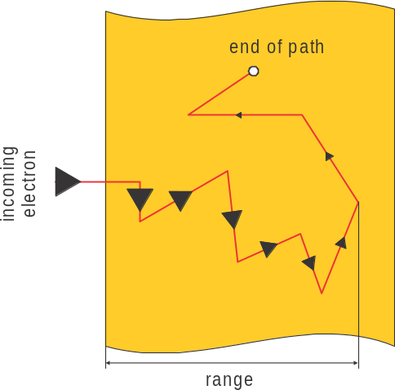
Direct ionization (cont’d)
Heavy charged particles have large specific ionization, large stopping power and small range
  Alpha particle range: 1 cm in air or 12 µm in water
Light charged particles have much smaller specific ionization and stopping power
  Beta particles are deflected on collision
  Path is a series of zig-zags
  Range of beta particles is greater than
  range of heavy particles (8 m in air
  and a few mm in metals)
Path of an electron in matter
Notes:
Heavy charged particles (alpha particles, fission fragments) are characterized by large specific ionization and stopping power and a small range. The path of heavy particles is linear since they are considerably heavier than electrons in matter. The range of an alpha particle with 2 MeV energy is around 1 cm in air but only a few μm in denser substances.
Light charged particles (beta particles or electrons and positrons) have much smaller specific ionization and stopping power than heavy charged particles. Since their mass is identical to the mass of electrons, they are deflected on colliding with electrons in atoms to the same degree as the electrons. This is why their path follows a series of angles or zig-zags. Their range is longer than for heavy charged particles; a beta particle of 2 MeV energy has a range of around 8 m in air and a few mm in metals.

Slide 30
Interaction of gamma rays with matter
Gamma rays and X-rays are similar
  Gamma rays originate from changes in nuclei
  X-rays originate from electron cloud of an atom
  Generally, X-rays have lower energy than gamma rays
Gamma rays travel through space at constant speed (speed of light) in a straight line until interaction with nuclei or electrons
Most important interactions are:
  Photoelectric effect
  Compton scattering
  Pair production
Notes:
Gamma rays are photons or packets (quanta) of electromagnetic radiation with a very short wavelength. X-rays are similar in this respect, except that γ rays originate from changes in atomic nuclei, whereas X-rays originate from the electron cloud (and not the nucleus) of an atom and generally have less energy than gamma rays. All other properties of gamma and X radiation are the same, so the interaction of both types of electromagnetic radiation with matter will be discussed together.
Photons move in a straight line at constant speed (the speed of light). As they travel though matter, they interact with atomic electrons and in some cases also with atomic nuclei. The most important interactions between gamma photons and atoms are:
the photoelectric effect,
Compton scattering,
pair production.

Slide 31
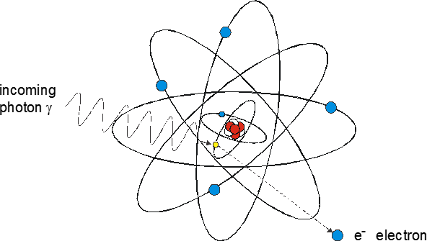
Photoelectric effect
Leads to complete photon absorption
Photon hits a bound electron in an atom and passes all energy to electron. Photon disappears
Electron is emitted with kinetic energy of the photon (less the binding energy of the electron)
Emitted electron travels through matter
just as a beta particle would
Notes:
The photoelectric effect leads to complete photon absorption. The photoelectric effect involves a photon hitting one of the bound electrons in an atom and passing all its energy to this electron. The photon disappears as the electron is emitted by the atom with a kinetic energy equal to the photon’s energy minus the electron’s binding energy. This binding energy is usually considerably smaller than the gamma ray energy, so the knocked-out electron has considerable kinetic energy and travels on through matter like a beta particle would.

Slide 32
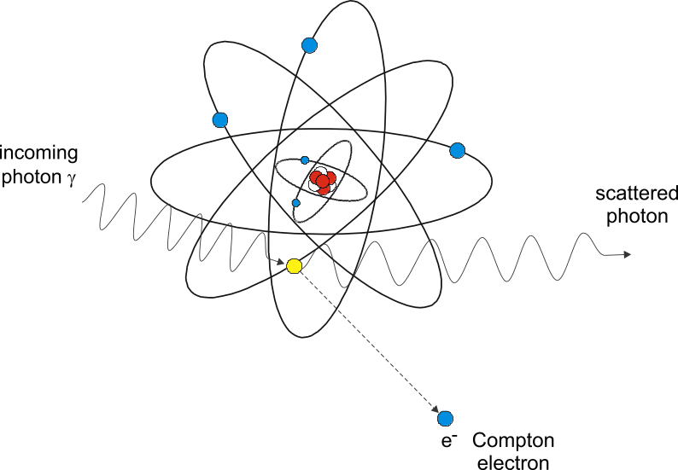
Compton scattering
Photon hits a bound electron in an atom and passes some of its energy to electron
Emitted electron travels through matter just as a beta particle would
Photon’s remaining energy emitted in the form of a new photon
Notes:
Compton scattering is a process in which a photon hits an electron in an atom. Part of the photon’s energy is received by the struck electron which consequently starts moving through matter like a beta particle, while the remaining energy is emitted in the form of a photon. Its energy is clearly smaller than that of the original photon, since the overall energy is conserved. Momentum is also conserved, which is why the electron and new photon fly off at defined angles.

Slide 33
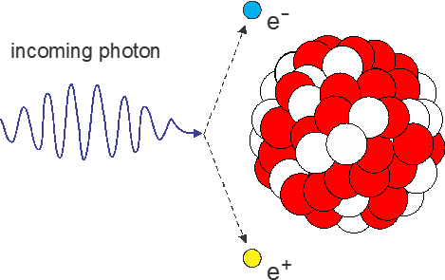
Pair production
Pair production occurs when high energy photon approaches atomic nucleus
In interaction with nucleus electric field, electron and positron are created, while photon disappears.
  Electron and positron fly off in opposite directions
The production of electron-positron
pair requires 1.02 MeV, remaining
energy of original photon is shared
among electron and positron
Notes:
Pair production occurs when a high energy photon approaches an atomic nucleus and the strong electric field of the nucleus creates a positron and an electron pair which fly off in opposite directions while the photon disappears. The production of the electron-positron pair requires 1.02 MeV, and the remaining energy is shared among the electron and positron. Pair production is relevant only to photons with high energy (>> 1.02 MeV).

Slide 34
Attenuation of gamma radiation
Photons do not interact with many atoms before disappearing
Interaction is random
Cannot define a range for gamma radiation
Can predict the probability of a gamma photon being scattered or absorbed as it travels a certain thickness of matter
For a given photon flux, the number of photons that travel a certain distance without interaction reduces exponentially
Notes:
Unlike charged particles, which continuously lose energy as they travel through matter, photons interact with atoms more rarely, but when they do they lose all their energy (absorption) or a considerable portion of it (scattering) at once. Consequently, the range of photons cannot be defined like for charged particles; we can only predict the probability of a photon scattering or being absorbed as it traverses a certain thickness of matter. This means that the interaction of gamma rays with matter is a random phenomenon. The probability of interaction per unit path length is given by the linear attenuation coefficient, μ.

Slide 35
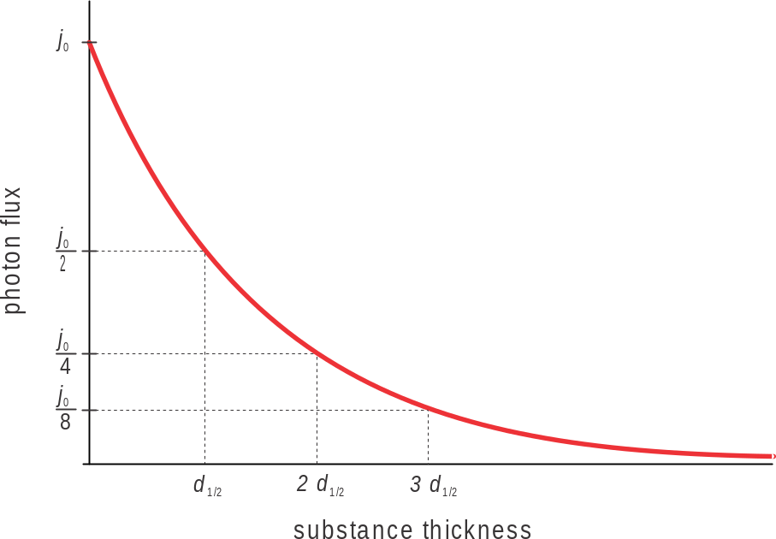
Attenuation of gamma radiation (cont’d)
Number of photons which travel a certain distance without scattering or being absorbed also reduces exponentially
Half-value layer (d_{1/2}) is the
thickness of a substance where
the flux of photons is reduced
to half its initial value
Exponential attenuation
of photon flux
Notes:
In mathematical terms, the process of photons travelling through matter may be compared to radioactive decay which is likewise a random process. Just as the number of radioactive nuclei diminishes exponentially with time, the flux of monoenergetic photons, j, which travel a certain distance without scattering or being absorbed also reduces exponentially. In this context, the half-value layer, d_{1/2}, is defined as the thickness of a substance at which the flux of photons is reduced to half its value.

Slide 36
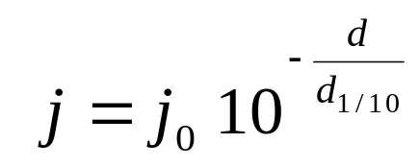
Attenuation of gamma radiation (cont’d)
Tenth-value layer (d_{1/10}) is also used: the thickness of material at which flux is reduced by factor 10
For tenth-value layer, the following equation applies:
Connection between half-value layer and tenth-value layer:
d_{1/10} = 3.3 d_{1/2}
Notes:
In addition to the half-value layer we also refer to the tenth-value layer, d_{1/10}, the thickness of a substance at which the flux of photons is reduced by a factor of 10; after passing two tenth-value layers by a factor of 100, after three tenth-value layers by a factor of 1000, etc. The exponential law of attenuation can be expressed through the tenth-value thickness (equation on the slide).
The half-value layer and tenth-value layer are related as follows:
d_{1/10} = 3.3 d_{1/2} .

Slide 37
Neutrons
No electrical charge
Interact with nuclei through nuclear reactions
Similar to gamma rays, the flux of neutrons decreases exponentially as they progress through material
Travel through matter until they collide with a nucleus, which happens randomly
Result of collision could be either:
  Scattering: neutron bounces off
  Absorption: nuclear change occurs
Notes:
Neutrons are electrically neutral particles, so there is no electric interaction with electrons or atomic nuclei. They interact with atomic nuclei only by nuclear reactions via the nuclear force, which, however, has a very short range. Since the nucleus takes up a very small part of the atom’s volume (the radius of the nucleus is ten thousand times smaller than the radius of the atom) neutrons travel through matter as through almost empty space. Owing to the random nature of neutron interaction with matter, the intensity (flux) of neutrons attenuates exponentially with the thickness of substance. Only now and then neutrons happen to collide with atomic nuclei, when the neutron either bounces off the nucleus (neutron scattering) or is absorbed by it, causing a nuclear change.

Slide 38
Absorption of neutrons
Neutrons released in fission and other nuclear reactions are fast neutrons
As they collide with nuclei in matter, they lose some kinetic energy and eventually slow down to become thermal neutrons
Thermal neutrons can be absorbed (captured) by a nucleus
For radiation protection purposes, this absorption results in the production of ionizing particles and/or gamma rays
Notes:
In contrast to scattering where a neutron slows down, absorption involves a nucleus capturing a neutron. The most common absorption reactions include radiative capture or the (n, γ) reaction, capture reactions with emission of other particles such as (n, α) and (n, p) reactions, and fission or (n, f) reaction.
In radiative capture or capture with emission of other particles the neutron does not reappear after the reaction, hence these reactions reduce the number of neutrons in matter.

Slide 39
Exercise #2
For the sources on the following slide, complete the following:
  List type/types of emitted radiation (alpha, beta, gamma, neutrons)
  Describe mechanism through which radiation interacts with matter (if more types of radiation are emitted, a participant should explain et least one type)
  State whether the radiation is directly or indirectly ionizing
Notes:
Consider dividing the participants into groups and having each group only do two or three sources, but have all groups do operating nuclear reactor.

Slide 40
Exercise #2 (cont’d)
Cobalt 60
Cesium 137
Strontium 90
Tritium
Potassium 40
Fresh (unirradiated) nuclear fuel
Reactor core (operating)
Reactor core (shutdown)

Slide 41
Radiation detection

Slide 42
Learning objectives
Describe the basic principle of detecting radiation with gas detectors
Describe how an ionization chamber works
Describe how dosimeters work

Slide 43
Physical basis of radiation detection
Human senses cannot detect ionizing radiation
Instruments that measure consequences of interaction of radiation with matter are needed:
  Production of free electrons and ions (ionization)
  Production of excited atoms
  Heating of matter
  Nuclear reactions in matter
  Bremsstrahlung (electromagnetic radiation from deceleration of charged particles in matter)
Notes:
We are unable to detect ionizing radiation with our senses, but we can detect and measure it with instruments, which are based on the mechanisms by which radiation interacts with matter. The consequences of the interaction of radiation with matter that can be exploited for detection are:
the production of free electrons and ions in matter (ionization),
the production of excited atoms,
the heating of matter,
the occurrence of microscopic damage to matter,
nuclear reactions in matter,
bremsstrahlung (electromagnetic radiation which results from the deceleration of charged – in particular β – particles in matter).
The effect most frequently exploited for detection is ionization.

Slide 44
Detector
Ionization is most common method of detection
Detector has a volume of matter where charges from ionization are collected
Detectors are based on type of matter where ionization is observed
  Gas detectors
  Scintillation detectors
  Semiconductor detectors
Dosimeters are detectors calibrated to register absorbed dose
Notes:
The device in which ionization is observed is called a detector. The volume of matter used to collect the resulting charges is called the active volume of the detector and must be large enough to absorb a substantial part of the energy of the radiation. This is why alpha particle detectors can be much smaller than photon or neutron detectors. Based on the type of matter undergoing ionization, the following main types of detectors are distinguished:
gas detectors,
scintillation detectors,
semiconductor detectors,
other detectors.
In some detectors, the number of pulses measured is related to the energy absorbed in the detector. Such a detector can be calibrated to show the absorbed dose, which is why it is called a dosimeter.

Slide 45
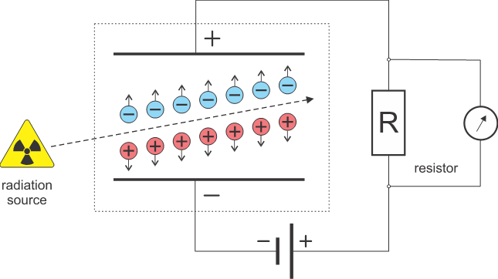
Gas detectors
A condenser is filled with gas and connected to high voltage source
Radiation ionizes gas, and electric field separates ions
When charges reach electrodes, electric current in circuit is registered
Notes:
In principle, a gas detector is a condenser inside which radiation ionizes a gas. Ion pairs are formed; negative particles (electrons) accelerate towards the positive electrode (anode) and positive ones (ions) towards the negative electrode (cathode). This produces an electric current which is then additionally amplified and registered.

Slide 46
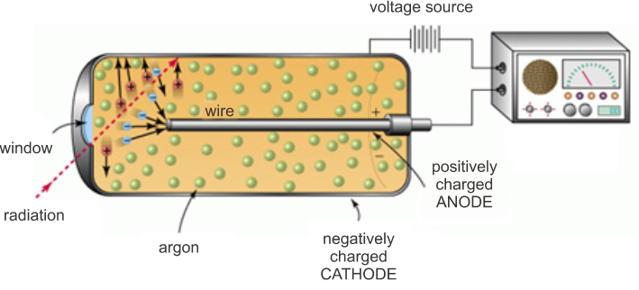
Coaxial gas detectors
Most common geometry
Alpha and beta particles enter through window
Gamma radiation primarily interacts with tube wall
Notes:
In principle, a gas detector is a condenser inside which radiation ionizes a gas. Ion pairs are formed; negative particles (electrons) accelerate towards the positive electrode (anode) and positive ones (ions) towards the negative electrode (cathode). This produces an electric current which is then additionally amplified and registered.

Slide 47
Ionization chambers
Voltages are between 100 V and 300 V
Filling gas is usually air
Electric currents are low and considerable amplification is required
Suitable for strong radiation fields
Used for measuring absorbed dose and reactor power

Slide 48
Proportional counters
Voltages are typically 300 V to 700 V
Signals do not require amplification
Filling gas is xenon, argon or methane
Used for dose rate, contamination and reactor power measurement

Slide 49
Geiger-Mueller counters
Voltages are between 1000 V and 1200 V
Signals are high
Cannot directly measure absorbed energy, only register ionization events
Used for detection of gamma and X-rays, and also alpha and beta radiation (contamination probes)
Often used in affordable handheld instruments, where high accuracy is not essential

Slide 50
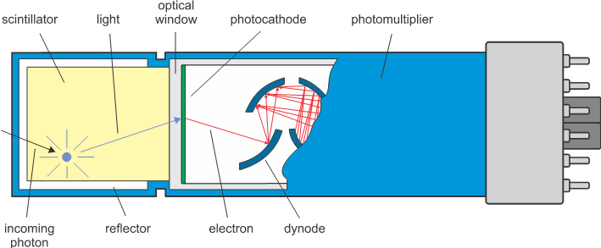
Scintillation detector
Some materials emit light (scintillate) after absorption of radiation
Common example is a CRT TV screen which emits visible light when hit by an electron beam
Notes:
Some crystalline substances and organic materials (called scintillators) are luminescent, which means they emit light after absorbing radiation. The best-known example is a CRT TV screen which emits visible light when hit by an electron beam from the cathode tube. This effect is exploited by scintillation detectors. They consist of a scintillator which is transparent to its own light, a photomultiplier and supporting electronics.

Slide 51
Scintillation detector (cont’d)
Most common scintillator for detecting gamma radiation is sodium iodine doped with thallium (NaI(Tl))
After absorbing ionizing radiation, light emitted as small spark
Light intensity is proportional to absorbed energy
Light detected with photomultiplier tube
Scintillation detectors are much more sensitive than gas detectors
Notes:
The most frequently used scintillator is a sodium iodine crystal doped with thallium, denoted by NaI(Tl).
A photomultiplier changes light pulses into electric pulses. The output electric signal is directly proportional to the energy of incoming radiation absorbed in the scintillator. A scintillation counter can therefore measure the energy of incoming radiation. Its second advantage is that the pulse develops in an extremely short time (μs), so it can also be used in a strong radiation field. Finally, the scintillation crystal absorbs gamma rays much more effectively than the thin gas in gas detectors, so it is used chiefly to measure gamma radiation.

Slide 52
Thermoluminescent dosimeter (TLD)
Used as personal dosimeter
Contains a small tablet built from crystalline material such as CaF₂ or LiF
When radiation is absorbed, electrons with increased energy levels captured
When heated, the electrons return to their ground state, emitting photons
Measuring emitted photons provides information on energy absorbed in TLD
Notes:
To measure the quantities of radiation a human being has been exposed to we use personal dosimeters. They measure the dose received or the energy absorbed per unit mass of matter. In the past, a photographic emulsion was used for this purpose, but today we most frequently use a thermoluminescent dosimeter (TLD), an optically stimulated luminescence dosimeter (OSLD) or an electronic dosimeter.
In thermoluminescent substances (e.g. CaF₂, LiF), radiation excites electrons to higher energy levels just like in scintillators. However, these electrons are not immediately restored to the ground state (emitting light in the process) as in scintillators but remain captured in what we call traps. The direct transition of an electron from a trap into the ground state is not possible. This only happens when additional energy is supplied to them, which is done by heating. Luminescence occurs when a photon is emitted during the transition into the ground state.

Slide 53
Optically stimulated luminescence dosimeter (OSLD)
Principle similar to TLDs, but use Al₂O₃
Main difference is that luminescence is stimulated with green laser light

Slide 54
Similarities between TLDs and OSLDs
Both are passive dosimeters: luminescent material is irradiated and reading is taken later
Depending on composition, either can be used to measure beta, X-rays, gamma rays and neutrons
Both can be reused after reading

Slide 55
Differences between TLDs and OSLDs
When a TLD is heated, the reading is erased
When an OSLD is read, the reading is not erased (could be re-read if necessary)

Slide 56
Neutron detection
For detection of thermal neutrons, following reactions are used:
¹⁰B (n, α) ⁷Li
⁶Li (n, α) ³H
³He (n, p) ³H
²³⁵U (n, f) and ²³⁹Pu (n, f).
Standard gas detector becomes sensitive to neutrons when target atoms are added to gas
Notes:
Like photons, neutrons belong to the family of indirectly ionizing particles. An important distinction is that photons react to a lesser or greater extent with virtually all substances to form charged particles, whereas neutrons form charged particles only in a relatively small number of nuclear reactions.
To detect slow, i.e. thermal neutrons, the following nuclear reactions are used:
¹⁰B (n, α) ⁷Li
⁶Li (n, α) ³H
³He (n, p) ³H
²³⁵U (n, f) and ²³⁹Pu (n, f).
A substance containing the atoms of one of the targets in the above reactions is added to a standard gas counter (e.g. ionization chamber or proportional counter).

Slide 57
Discussion question
Does anyone have experience with any type of radiation detector?
What can you tell us about them?

Slide 58
Practical exercise on radiation detection
If the host organization has any radiation detection equipment, have someone bring and demonstrate the operation.
Assume that the classroom is a typical room in a NPP. Demonstrate how to conduct a radiation survey of the room.
Have the candidates practice taking swab samples for contamination
Notes:
If the host organization has any radiation detection equipment, have someone bring and demonstrate the operation.
Assume that the classroom is a typical room in a NPP. Demonstrate how to conduct a radiation survey of the room.
Have the candidates practice taking swab samples for contamination

Slide 59
Dosimetric quantities

Slide 60
Learning objectives
Define absorbed dose and absorbed dose rate
Define radiation weighting factors for alpha, beta and gamma radiation and neutrons
Define tissue weighting factors
Define effective dose and its units

Slide 61
Absorbed dose (D)
Basic dosimetric quantity
Defined as energy of radiation deposited per unit mass
SI unit is gray (Gy): 1 Gy = 1 J/kg
In radiation protection, smaller units are used:
  1 mGy = 10⁻³ Gy
  1 µGy = 10⁻⁶ Gy
Former unit, rad:
  1 rad = 0.01 Gy
  1 Gy = 100 rad
Notes:
In order to discuss the issues of radiation and radiation protection, we need a suitable set of physical quantities and units to quantitatively describe radiation fields and their effects.
In the context of nuclear physics, we have already met activity, a physical quantity defined as the number of radioactive disintegrations per unit time. Although the activity of a source is related to the exposure to the radiation emitted by the source, the primary concern is how much of this radiation actually reaches us. The situation can be compared to a loudspeaker heard from a certain distance. If the loudspeaker’s power is compared to source activity, we still need a quantity which corresponds to the volume at the location of the listener.
The basic dosimetric quantity is called the absorbed dose, D, defined as the energy of radiation deposited (absorbed) in unit mass:
D=…
The unit for absorbed dose is the gray, in abbreviated form Gy, which is defined as:
1 Gy = 1 J/kg
A target thus receives a dose of 1 Gy if 1 J of ionizing radiation is deposited in 1 kg of matter. More frequently used and smaller units are the mGy and µGy.
1 mGy = 0.001 Gy = 10⁻³ Gy
1 μGy = 0.000001 Gy = 10⁻⁶ Gy
The old unit, which is often found especially in U.S. literature and regulations, is the rad and is a hundred times smaller than the gray:
1 rad = 0.01 Gy
1 Gy = 100 rad

Slide 62
Absorbed dose rate
Tells us how quickly absorbed dose in target increases
Unit for absorbed dose rate is Gy/h (also mGy/h, µGy/h)
Notes:
The absorbed dose rate, Ḋ, tells us how quickly the absorbed dose to the target increases.
Ḋ=ΔD/Δt
The absorbed dose rate is measured in units of Gy/h, mGy/h etc.

Slide 63
Point sources of radiation
Point source is when the distance to the target is more than three times the dimension of the source
Radiation spreads out in all directions from a point source
Absorbed dose rate is directly proportional to point source activity
Absorbed dose rate is inversely proportional to the square of the distance from the source
Notes:
In case of a point source (a source of radiation may be considered as a point source when its distance from the target is more than 3 times its dimension) of radiation with activity Ac, radiation spreads from it isotropically, i.e. evenly in all directions.
Let us consider the simplest example, where a radionuclide emits one photon with each decay. At distance r from the source, the photons spread evenly over the surface of a sphere with radius r, so that S = 4πr². At this distance, the photon flux thus equals (see slide)
Φ=…
The dose rate is the product of the number of photons absorbed in the target per unit time, and the energy they pass to the target on absorption. The number of photons absorbed in the target is proportional to the number of photons reaching the target, i.e. the photon flux. This means the dose rate is proportional to the photon flux (see slide):
Ḋ=…
The absorbed dose rate is directly proportional to the point source activity and inversely proportional to the square of the distance from the source.

Slide 64
Line sources of radiation
Dimension of source is greater than distance to the target
Example: pipe with radioactive fluid
Absorbed dose rate is proportional to the activity per unit of source length
Absorbed dose rate is inversely proportional to the distance from the source
Notes:
We also frequently deal with line sources of radiation, e.g. a pipe carrying radioactive fluid. The dose rate falls inversely proportionally to the distance from the line source.

Slide 65
Equivalent dose (H)
Damage to live cells, tissues and organs from exposure to ionizing radiation depends in part on absorbed dose
However, it also depends on the type of radiation and on the energy of radiation
Radiation with high linear energy transfer (LET) will cause more damage than radiation with low LET
  LET is quantity of energy transfer to matter per unit length of path
  Alpha particles, protons and neutrons have high LET
  Beta particles and gamma radiation have low LET
Notes:
Things would be simple if radiation effects were directly proportional to the absorbed dose. Unfortunately, they are not. Besides the energy deposited in the body by radiation, the degree of biological damage also depends on the type of incoming radiation and sometimes on the energy of the particles.
Biological effects increase with the stopping power of particles which is also called linear energy transfer – LET. This means that particles with a large LET (alpha particles, neutrons) cause more damage than particles with a small LET (beta and gamma particles) at the same absorbed dose.

Slide 66
Equivalent dose (cont’d)
Equivalent dose takes into account both absorbed energy and characteristics of the energy transfer to target material
H = w_{R} · D
w_{R} is radiation weighting factor (between 1 and 20)
SI unit for equivalent dose is sievert (Sv)
For radiation protection purposes, mSv and µSv are used
Former unit is rem:
  1 rem = 10 mSv
  1 Sv = 100 rem
Notes:
Since there is no easy way of adequately expressing the dependence of biological effects on linear energy transfer by a simple mathematical formula, we need to introduce the radiation weighting factor w_{R} which accounts for the differences in the quality (effectiveness) of various radiations.
To estimate the degree of biological damage, we introduce a new dosimetric quantity, called the equivalent dose, H, defined as the product of the absorbed dose and the radiation weighting factor w_{R}:
H = w_{R} · D
The unit for equivalent dose is called the sievert (Sv). This unit is used to point out that we are dealing with equivalent and not absorbed dose (the unit of the latter is Gy), although both can be expressed with the same basic physical units:
1 Sv = 1 J/kg
An equivalent dose of 1 Sv is a very large dose, so we often use smaller units, mSv and µSv.
The old unit for equivalent dose, which is still encountered in American literature and legislation, is the rem (roentgen equivalent man):
1 rem = 0.01 Sv = 10 mSv
1 Sv = 100 rem

Slide 67
Radiation weighting factors (w_{R}) (ICRP)
type of radiation | Energy | w_{R}
alpha (α) | all energies | 20
beta (β) | all energies | 1
gamma (γ) | all energies | 1
neutrons (n) | continuous function of energy | 2.5 ~ 20

Slide 68
Equivalent dose rate
SI unit is Sv/h
mSv/h and µSv/h more commonly used

Slide 69
Effective dose (E)
Not all organs (or tissues) are equally sensitive to radiation
Consequences of exposure to radiation vary depending on whether equivalent dose is received by whole body or just a part of the body
Effective dose expresses the share of whole body effects from exposure of particular organ or tissue:
E = w_{T}·H
w_{T} is organ weighting factor
Notes:
The biological consequences vary if a given equivalent dose is received by the whole body or just by a part of the body or an organ. In terms of biological effects, we also find that not all organs are equally sensitive to radiation, i.e. the same equivalent dose produces more harmful effects in some organs than in others.
This is why another quantity was introduced, the effective dose, E, which basically expresses the share of whole body effects contributed by a particular organ or tissue.
If several organs are irradiated, each with its own dose, H_{T}, the total effective dose is sum of partial effective doses.

Slide 70
Organ or tissue weighting factors (ICRP 2007)
tissue or organ | w_{T}
breast | 0.12
bone marrow | 0.12
colon | 0.12
lung | 0.12
remainder | 0.12
stomach | 0.12
gonads | 0.08
bladder | 0.04
liver | 0.04
oesophagus | 0.04
thyroid | 0.04
bone surfaces | 0.01
brain | 0.01
salivary glands | 0.01
skin | 0.01
TOTAL | 1.00

Slide 71
Effective dose (cont’d)
SI unit for effective dose is Sv
Concept of effective dose only makes sense for low doses (where E << Sv)
Organ and tissue weighting factors also apply only for low doses
Notes:
As for equivalent dose, the unit for effective dose is the Sievert (Sv). It should be emphasized that using the concept of effective dose only makes sense at low doses (E << Sv) and that tissue weighting factor values also apply to low doses only.

Slide 72
Collective dose (E_{c})
When a group of people is exposed to radiation, collective dose is calculated
Sum of effective doses of all group members
SI unit for collective dose is person·Sv

Slide 73
Exercise #3a
A stainless steel screw (SS304, mass 10 g) has fallen in research reactor pool and rested on reflector belt near the reactor core. It is estimated that the activities of gamma emitting radionuclides in the steel are:
  ⁵¹Cr: 6.3 MBq (27.7 d, Γ_{air} = 5.45·10⁻¹⁵ Gy·m² ·h⁻¹·Bq⁻¹)
  ⁵⁶Mn: 1.1 GBq (2.58 h, Γ_{air} = 2.2·10⁻¹³ Gy·m² ·h⁻¹·Bq⁻¹)
  ⁵⁹Fe: 0.075 MBq (44.53 d, Γ_{air} =1.57·10⁻¹³ Gy·m² ·h⁻¹·Bq⁻¹)
  ⁶⁵Ni: 5.3 MBq (2.52 h, Γ_{air} = 8.0·10⁻¹⁴ Gy·m² ·h⁻¹·Bq⁻¹)

Slide 74
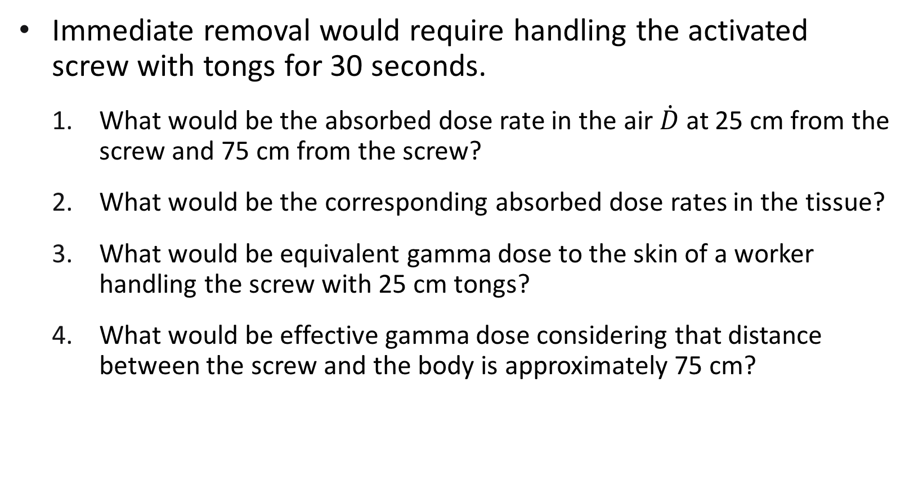
Exercise #3a (cont’d)
Immediate removal would require handling the activated screw with tongs for 30 seconds.
  What would be the absorbed dose rate in the air $\dot{D}$ at 25 cm from the screw and 75 cm from the screw?
  What would be the corresponding absorbed dose rates in the tissue?
  What would be equivalent gamma dose to the skin of a worker handling the screw with 25 cm tongs?
  What would be effective gamma dose considering that distance between the screw and the body is approximately 75 cm?

Slide 75
Biological effects of radiation

Slide 76
Learning objectives
Explain how radiation directly and indirectly affects the cell
Distinguish stochastic and deterministic effects
List the deterministic effects of radiation
List the stochastic effects of radiation

Slide 77
Basic cell biology
Cells are basic building blocks of living organisms
Human body consists of around 4·10¹³ cells
Cell types
  Somatic (bodily) cells
  Sex cells (or gametes, relevant to reproduction)
Most cells are somatic cells
Notes:
The basic building blocks of living organisms are cells.
The body of an adult person consists of around 4·10¹³ cells. Cells differ from each other both in function and size. Most cells are relatively small (around 10 μm), whereas nerve cells can be up to a metre long. Cells fall roughly into two families: somatic cells and sex cells. Almost all cells in the body are somatic cells, and sex cells or gametes are only relevant to reproduction. Gametes pass hereditary information from one generation to the next.

Slide 78
Basic cell biology (cont’d)
Cells composed of ~70-85% water, ~10-20% proteins, ~10% sugars, ~2-3% fats and small quantities of inorganic substances
Cells in some tissues divide every 24 hours, while others only once in a lifetime
Notes:
Cells are composed of ~70-85 % water, ~10-20 % proteins, ~10 % carbohydrates (sugars) and ~2-3 % lipids (fats) and small quantities of inorganic substances

Slide 79
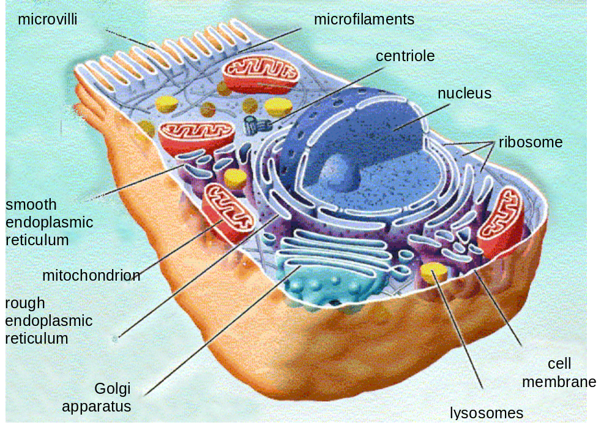
Somatic cell

Slide 80
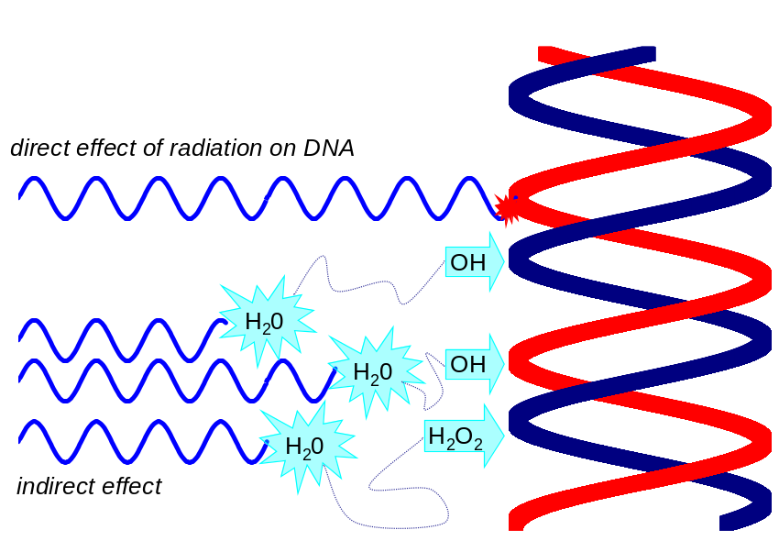
Radiation effects on cells
When exposed to ionizing radiation, some molecular bonds in cells are broken, forming free radicals
Direct effect of ionizing radiation is when an organic molecule splits or is damaged due to ionization
Indirect effect of ionizing radiation is when water molecules are ionized
  This results in the creation of
  hydroxyl radicals and hydrogen
  peroxide. These in turn can
  damage organic molecules
  Essentially a chemical process
Notes:
No atom in a cell is free; all atoms are bound into molecules. Since molecular bonds are formed by electrons, ionization results in the breakdown of molecules or the formation of free radicals from previously neutral molecules.
When ionization causes a complex organic molecule in one of the organelles to split, this is a direct effect of ionizing radiation on the cell.
Since cells to a large extent (70-85 %) consist of water, it is more likely for radiation to ionize the water in the cell than to affect any of the (vital) organic molecules. Water ionization involves several chemical reactions called water radiolysis. Particularly important products of radiolysis include free hydroxyl radicals, OH˙, and hydrogen peroxide, H₂O₂. Both are strong oxidants which are able to travel approximately 4 nm from their point of origin, where they have a very aggressive effect on cell elements. This process is called an indirect effect of ionizing radiation and its consequences are very similar to those of the direct radiation effect. In forms of radiation that rarely ionize matter (have a low LET), the indirect effect accounts for around 70 % of damage; for high-LET radiation, this share is smaller than the direct effects. It is important to note that both processes are essentially chemical. The biological effects of radiation are thus basically no different from the effects caused by various chemicals. Radiation is just one of the ways in which harmful chemical substances are formed in or enter the body.

Slide 81
Radiation effects on cells (cont’d)
Radiation can damage any part of a cell, but effect depends on which part of the cell is damaged
  Nucleus and DNA in the nucleus are critical targets
  Damage to DNA affects cell function and may be transferred to its progeny during cell reproduction (mitosis)
Many damaged cells continue to function until reproduction, when they die
  Radiation effects are most dramatic in organs with quickly dividing cells (red marrow, large intestine, skin, hair follicles)
Embryos are very sensitive to radiation, especially in the first months after conception
Notes:
The cell is such a complex system that, even at the cellular level, there is no single mechanism through which radiation acts on the body. Radiation effects depend on which of the cell organelles is affected and what its role is in cell functioning. Although not all the details are understood as yet, many studies suggest that the most sensitive part of the cell is its nucleus, specifically the chromosomes. Of course, radiation may also damage other organelles. If damage is caused to a large molecular group, e.g. in the mitochondrion, the function of this mitochondrion will very likely be impaired or fail entirely. However, there are several mitochondria in most cells which can take over its role. On the other hand, damage to the cell DNA affects the function of the cell as a whole and may be transmitted to its progeny by mitosis. DNA is therefore a critical target for ionising radiation.
As it turns out, many cells damaged by radiation continue to function. During mitosis, however, a defective chromosome prevents them from dividing properly and they die. This is called mitotic death. Radiation effects are therefore most dramatic in organs with the most quickly dividing cells (red marrow, large intestine epithelium, skin epithelium, hair follicles). In contrast, tissues which are more static such as muscles and bones are less sensitive to radiation. Also very sensitive to radiation are embryos, especially in the first months after conception, because their cells divide at a much faster rate than in adults

Slide 82
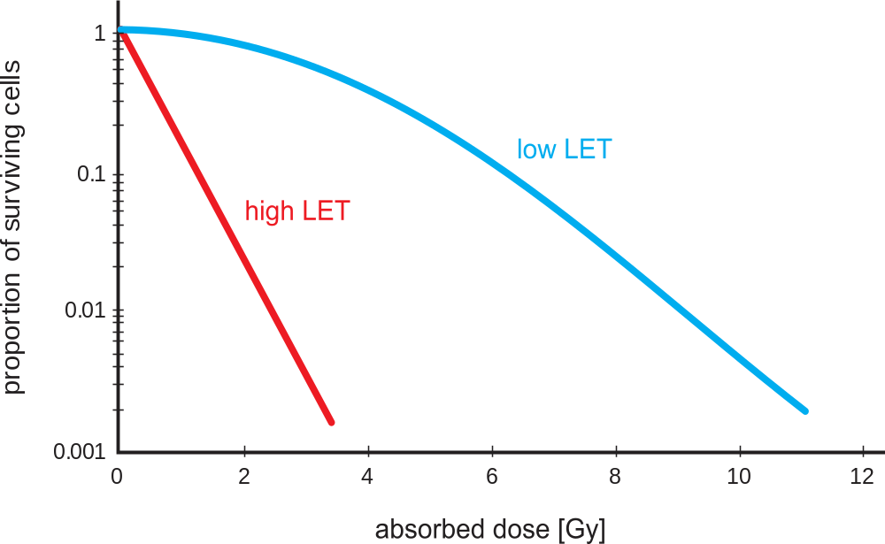
Effect of linear energy transfer (LET)
Radiation with high LET (alpha or neutrons) cause much greater biological damage than radiation with low LET (beta or gamma)
Some evidence of a repair
mechanism that enables
damaged cells to recover
if exposed to low doses
of low-LET radiation
Notes:
Parts of certain animal tissues can be removed and then grown in cell colonies which multiply spontaneously by cell division. Exposing such a colony to a short-term, acute dose of radiation enables very precise measurement of cell death as a function of dose. Figure on the slide shows the proportion of surviving cells as a function of the absorbed dose. This figure very clearly indicates that radiation with high stopping power or a high linear energy transfer (LET), e.g. alpha radiation or neutron radiation, causes much greater biological damage than radiation with a low LET such as beta and gamma radiation at the same absorbed dose. This example illustrates why absorbed dose is insufficient to describe biological effects and why we also need to use the equivalent dose, which multiplies the absorbed dose by the relevant radiation weighting factor. Figure also shows that the proportion of cells surviving irradiation with a high LET radiation falls exponentially (the chart uses a logarithmic scale for the vertical axis) with increasing dose, whereas in low-LET radiation, the proportion of surviving cells decreases very slowly at lower doses and only starts falling exponentially at high doses. Although the process of cell death is not yet fully understood, this suggests that some kind of repair mechanism exists in cells at low doses and low-LET radiation which reduces the number of cells killed.

Slide 83
Mutation and cancer
After damage, some cells keep the ability to divide further
The damage in the DNA is passed to the next generation (called mutation)
Mutations may also cause abnormal functioning of individual organs or greatly increased rate of cell division (called cancer)
Ionizing radiation is only one of many causes of mutation and cancer
  Radiation damage is essentially a chemical process, other environmental factors have similar effects
Notes:
In certain cases, the damaged cells keep the ability to divide further. As they divide, the change in their chromosomes is passed to the next generations of cells. This phenomenon is called mutation. Just as the mechanism of the effects of ionizing radiation on the cell is basically no different from the mechanism that underlies the effects of other environmental factors, mutations in the body are by no means caused by radiation alone; they are so to speak a daily occurrence produced by various external influences on cells.
Alternatively, mutations may cause pathological changes which are manifested as the abnormal functioning of individual organs or as a greatly increased rate of cell division in a tissue or organ. Such a pathological change is called cancer.

Slide 84
Genetic changes
When genetic material in sex cells is damaged, the mutation could be transferred to offspring
Pathological changes may develop in offspring, or in offspring’s offspring, and not in organism exposed to radiation
These effects are called hereditary effects
Notes:
If any chromosome in the sex cells (in the sex glands – gonads) is damaged, the mutation is transmitted to the offspring and it is only in them – and/or their offspring – that certain pathological changes will develop. This process is called genetic change.

Slide 85
Timeline of radiation damage
Physical phase: ~10⁻¹² s: ionization
Chemical phase: ~10⁻⁶ s: formation and diffusion of free
radicals
~10⁻³ s: DNA damage
Biological phase: ~seconds: DNA repair
~hours: cell death
~days: mutations, cell transformation,
chromosome aberrations
~years: cancer, hereditary effects

Slide 86
Radiation effects on humans
Type of cell damaged:
  Somatic effects, that occur on exposed person
  Genetic effects, that occur on exposed person’s offspring
Probability that radiation effect will occur:
  Deterministic effects, that will certainly occur after specific dose
  Stochastic effects, which will occur with certain probability only in a specified percentage of exposed persons
Notes:
The effects of radiation on humans can be classified by two criteria. The first classification refers to the type of cells damaged or to the person that suffers the effects of radiation. Symptoms which are a consequence of damaged somatic cells and occur in the irradiated person are called somatic effects. Symptoms which are a consequence of damaged gonads and occur in the irradiated person’s offspring are called genetic effects.
The second classification relates to the probability that the effect or medical condition will occur. Effects as a consequence of radiation which are certain to occur above a specific dose are called deterministic effects. These effects are a consequence of irreparable damage to cells and their death during unsuccessful division. Effects which occur with a certain probability only in a specific percentage of irradiated persons are called stochastic effects. These effects are a consequence of accumulated mutations in irradiated cells.

Slide 87
Radiation effects on humans (cont’d)
Effects of radiation depend not only on dose, but also how dose was received:
  Acute (total dose is received over short period of time)
  Chronic (dose is received over prolonged period of time)
  Local (exposure of particular organ)
  Whole body
Most information comes from the high dose acute radiation of the survivors of Hiroshima and Nagasaki
For a given dose, we assume that data from an acute exposure conservatively estimates effects from a chronic exposure
Notes:
The effects of radiation depend not only on the equivalent or effective dose received, but also on how this dose was received:
Acute: a high dose in a short time interval.
Chronic: prolonged irradiation with low doses.
Local: exposure of a particular organ.
Total: whole body irradiation.
Most information about the effects of radiation is drawn from cases of acute irradiation with high doses (e.g. survivors of the Hiroshima and Nagasaki bombings or accidents involving radiation sources). However, what is most relevant for the practical application of radiation protection principles, especially to occupationally exposed workers, is multiple (chronic) low dose irradiation. Since we know that repair mechanisms are at work at low doses, we may assume that an assessment of harmful radiation effects based on data from acute doses is a conservative assessment of the effects of chronic exposure to the same dose.

Slide 88
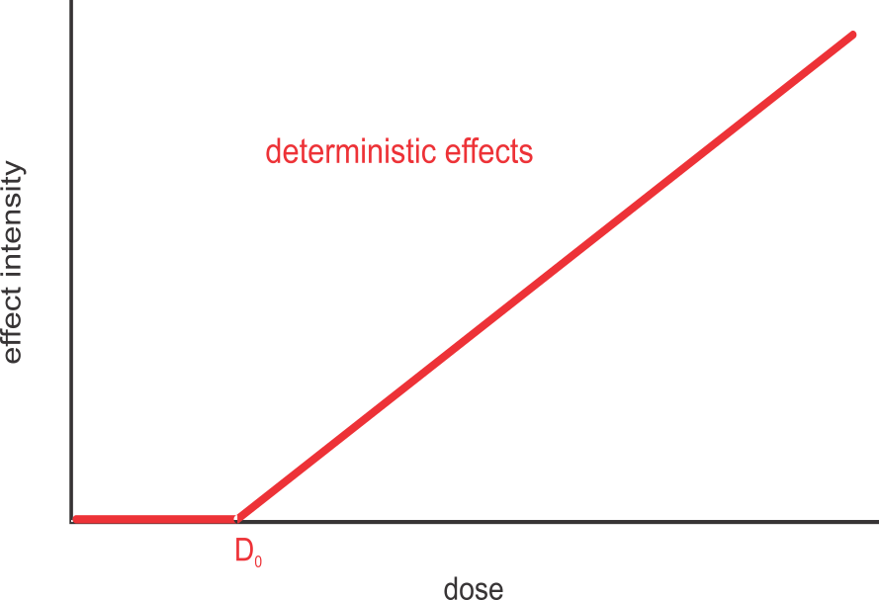
Deterministic effects of radiation
Certain to occur after irradiation with sufficient dose
Have a dose threshold (minimum dose at which effect occurs)
Severity or intensity of effect increases with dose above the dose threshold
Manifest shortly after
irradiation (hours to weeks)
Notes:
As the name tells us, deterministic effects are effects which are certain to occur following irradiation with a high enough dose. They will manifest after a short delay, hours to weeks after irradiation. They are also characterized by a dose threshold, i.e. the minimum dose, D₀, at which these effects occur. Below this threshold there are no radiation effects, and above it their severity or intensity increases with the dose received. Deterministic effects can also be unambiguously linked to excessive exposure to radiation.

Slide 89
Deterministic effects of radiation (cont’d)
Erythema (skin redness)
Epilation (hair loss)
Reduced number of blood cells (resulting from bone marrow damage)
Cataracts
Nausea, vomiting, diarrhoea
Damage to children (deformation of organs, mental retardation)
Temporary or permanent sterility
Protection against deterministic effects: keep doses below the threshold dose

Slide 90
Effects of acute whole body irradiation
Dose (Gy) | Probable effect
0 – 0.5 | No prominent effects, possible minor changes in blood count.
0.6 – 1.2 | Nausea and vomiting occur after first day in 5-10% of cases. No serious incidence of disease.
1.3 – 1.7 | The first day is followed by nausea and vomiting, 25% of cases display symptoms of radiation sickness. No fatal cases.
1.8 – 2.2 | In 50% of cases, nausea and vomiting occurs within first day. Symptoms of radiation sickness are more prominent. No fatal cases are expected.
2.3 – 3.3 | In 100% of cases, nausea and vomiting occur within first day. Serious signs of radiation sickness appear.
3.4 – 5.0 | Median lethal dose, LD_{50/30} – 50% deaths in 30 days.
> 100 | Radiation syndromes. 100% deaths with a time delay from a few hours to a few months.

Slide 91
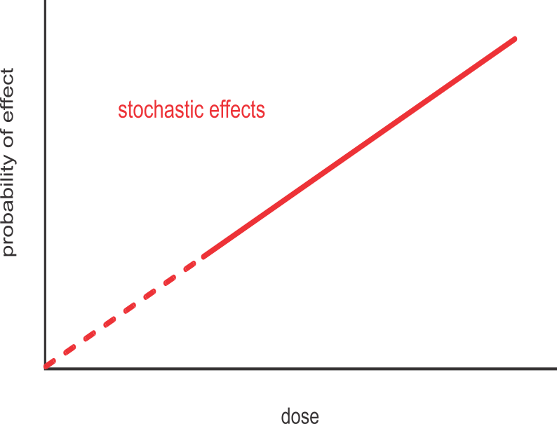
Stochastic effects of radiation
Can only be predicted to occur with a certain probability
No threshold dose
Probability of effect occurring increases with dose
Severity of effect not related
to dose
Occur years after exposure
Not possible to link radiation
exposure with effect unequivocally
Notes:
Stochastic effects of radiation are effects which can only be predicted to occur with a certain probability. In this case, a threshold dose, i.e. a minimum dose below which there is no risk of these effects, cannot be proved. A characteristic feature of stochastic effects is that the probability of a medical condition occurring rises with increasing dose, whereas the severity or intensity of an effect (in the case when it occurs) is not related to dose. Furthermore, the medical condition cannot be unequivocally linked to radiation exposure; all that may be determined is a statistical increase in the medical condition beyond its natural frequency or incidence due to other causes.

Slide 92
Stochastic effects of radiation (cont’d)
Include:
  Cancer
  Genetic effects
Most cancers are caused by carcinogens, many of which occur naturally and are present in environment
Radiation increases probability that a person will get cancer
Data from Hiroshima and Nagasaki survivors show that 35% of lethal leukaemia cases and 5% of lethal solid cancer cases were the consequence of irradiation
Notes:
Stochastic effects of radiation include in particular:
cancer,
genetic effects.
Cancer is (after cardiovascular diseases) the second leading cause of death. In the developed world, around 40 % of people contract cancer and almost 20 % die from cancer. Cancer is not a single disease but a group of around a hundred very similar diseases, all of which share rapid, uncontrolled division of cells. Over 90 % of cancers are caused by various chemicals which are called carcinogens. More than a thousand carcinogens are known and most of them occur naturally in the environment. Radiation is therefore just one – albeit not chemical – of many carcinogens. Among the 86572 surviving victims of the Hiroshima and Nagasaki bombings, 249 people died of leukaemia and 7578 of other types of cancer, but a comparison with other groups of people shows that only 87 of the leukaemia cases and 334 of the cases of other cancer types may be attributed to radiation exposure (UNSCEAR 2000 Report Vol. II), while the rest resulted from other, natural causes. This suggests that radiation is not a conspicuously strong carcinogen.

Slide 93
Stochastic effects of radiation (cont’d)
Probability of developing cancer is proportional to dose received
For low doses, probability is too low to be statistically significant
We assume that the proportionality between dose and probability for stochastic effects does not have a minimum threshold dose (linear no-threshold hypothesis)
Data suggest that relationship between dose and probability for cancer occurrence is 5% per person·Sv
Notes:
The bulk of the data on additional incidence of cancer was obtained by monitoring Hiroshima and Nagasaki survivors and from some accidents involving sources of radiation. What is characteristic of all these cases is that the individuals received relatively high radiation doses. It was also found that, at high doses, the probability of developing cancer is proportional to the dose received. For low doses, the number of additional disease cases was too small to be statistically identified. It was therefore assumed that even in low doses, the risk of cancer is proportional to the dose received and that there is no “safe dose” or threshold dose with no risk below that value. However, there are many indications that certain repair mechanisms exist at low doses which reduce this risk.
Taking a conservative approach, however, radiation protection regulations are based on the linear no-threshold hypothesis.
Leukaemia is the leading cancerous disease caused by radiation, followed by breast, lung, thyroid and stomach cancer. For each of these, the probability of occurrence can be determined and expressed as the number of expected deaths per specific collective dose. The total probability for any type of cancer is 5 % per 1 man·Sv.
What is also characteristic of all types of cancer is a latent period, i.e. the time between radiation exposure and the onset of cancer. In leukaemia the latent period is 5-15 years, and for other types of cancer it is 10 years or more.

Slide 94
Genetic effects of radiation
Another form of stochastic effect
Only observable in descendants of irradiated persons
Less probable than cancer
To date, effects have not been observed in descendants of irradiated persons
Notes:
Genetic effects are another type of stochastic effect of radiation. These are effects which are only displayed in the offspring of the irradiated person. Being even less probable than cancer, there has been so far no statistically proven increase of genetic effects in any group of irradiated persons.

Slide 95
External radiation exposure

Slide 96
Learning objectives
Describe examples of potential external exposure
Describe methods of protection against external exposure

Slide 97
External radiation exposure
When the source is located outside body:
Alpha radiation: stopped by the dead outer layer of skin and is not a hazard
Beta radiation: harmful in certain cases (close proximity to source, contamination of skin, direct eye irradiation
Gamma radiation: penetrating and therefore a potential hazard
Neutrons: penetrating and therefore a potential hazard
Notes:
The main objective of radiation protection, as its name implies, is protection against excessive exposure to radiation. This involves the important step of calculating or assessing the received dose or dose rate which depends on the configuration of the radiation source. The methods of protection as well as the calculation of the dose received very much depend on whether the source is located inside or outside the human body and on the type of radiation emitted by the source.
When the source of radiation is located outside the body, this produces external exposure. In this case, alpha radiation is harmless, because it is already stopped by the dead outer layer of the skin. Similarly, beta radiation is only harmful in some special cases (direct exposure to unshielded sources, skin contamination, direct eye irradiation) and safety is achieved just by wearing clothes and other protective items (safety spectacles, gloves). Thus, when dealing with external sources of radiation, it is most important to provide protection against gamma and neutron radiation. Since – except in some special cases – a reactor is a source of neutron radiation only during operation, the most important consideration in practice is protection against gamma radiation.

Slide 98
Protection against external exposure
Beta radiation: safety glasses, contamination control
Neutrons: for radiation protection purposes, the only source of neutrons is an operating nuclear reactor. Built-in shielding and administrative controls prevent exposure

Slide 99
Protection against external exposure (cont’d)
Gamma radiation is main source of external exposure in NPPs
External exposure may be controlled by three parameters:
  Time
  Distance
  Shielding
Each of these parameters can reduce dose, however effective radiation protection programmes use a combination of all three

Slide 100
Time
The less time spent in a radiation field, the smaller the dose received
Examples of good practices:
  Proper work planning and organization
  Pre-job briefings
  Training and rehearsals
  Preparation of tools and materials outside of the radiation area
  Optimizing protective clothing and equipment
  Delaying work until short-lived radionuclides have decayed
  Appropriate working conditions (ventilation, lighting, space)
Notes:
The less time is spent in a field of radiation, the smaller is the dose received. This time can be shortened, particularly with proper preparation and practice outside the radiation area. This is to ensure that the actual exposure time is the shortest time required to perform the job and that the chances of a mistake (and the need to do the same job again) are minimal. Examples of good practice for reducing time are:
precise planning and organisation of the work (breaking down the tasks beforehand),
meetings before the work is started (to plan and coordinate activities),
training on a mock-up,
preparing tools in a clean environment,
optimizing protective clothing,
video surveillance,
remote communication,
delaying the beginning of work (decay of short-lived nuclides),
ensuring appropriate working conditions (ventilation, lighting, appropriate supply of air).

Slide 101
Distance
Radiation dose rate falls as the distance from the source increases
Increase distance by:
  Using tongs, pincers, tweezers, etc.
  Using telescopic instruments
  Remote reading of instruments
  Remote control tools
  Indicating hot spots and radiation levels
  Removing radiation sources
  Removing equipment to be repaired from radiation areas
Notes:
The radiation dose rate falls with increasing distance: for point sources with the square of the distance, and for line sources proportionally with distance. The distance from the source of radiation may be increased by:
using telescopic measuring instruments (teletectors),
remote reading of instruments,
using tongs, pincers, tweezers and other adapted tools,
remote control of tools,
using video surveillance,
repairing portable parts in a hot machine shop,
using remote communication,
indicating hot spots and radiation levels,
removing sources of radiation.

Slide 102
Shielding
Can be permanent or temporary
Permanent shielding part of NPP design
  May include lead bricks, water tanks, concrete walls, etc.
Temporary shielding usually in the form of lead mats or screens
Installation of temporary shielding will require exposure of workers, so effect on collective dose must be considered
Preparation of effective shielding requires expert knowledge
Notes:
Although distance and time can be put to good use as protection against external radiation, shielding is a more reliable method of reducing dose rate. In principle shielding alone could be used, but in practice the scope of shielding depends on the possibilities (of the location or equipment involved in a job), the actual effect on collective dose (setting up a shield also results in radiation exposure), as well as the ratio between its cost and the expected benefits (dose reduction). Shielding consists of:
portable lead mats or screens,
lead bricks,
water (primary system, secondary side of steam generators),
existing concrete walls, etc.
Due to gamma ray scattering and bremsstrahlung, shielding calculations are not simple and an expert should be consulted on the topic.

Slide 103
Shielding from gamma radiation
With shielding, intensity of gamma radiation falls exponentially
These are only estimates and must always be verified with measurements
substance | d_{1/10} [cm]
water | 60
concrete | 25
steel | 10
lead | 5.6
Conservative values of tenth-value layers for radiation from spent fuel elements
Notes:
Since in addition to directly transmitted radiation Compton-scattered photons also penetrate the shield, a slightly higher value of the tenth-value layer is used to give a conservative assessment of shielding effectiveness regardless of photon energy. Its values for radiation from spent fuel elements are shown in table.
If the shielding thickness equals the one tenth-value layer, radiation is weakened by a factor of 10, at two such thicknesses by a factor of 10×10 = 100, at three thicknesses by 1000, etc.
The examples given provide merely a rough assessment of shielding effectiveness. For precise assessment or more complicated geometries, calculation is best left to the experts.

Slide 104
Shielding from beta radiation
Two contributions to exposure from beta radiation
  Beta radiation itself
  Bremsstrahlung produced by stopping electrons in matter
Beta radiation can be stopped by using a shield with thickness larger than beta radiation range
Bremsstrahlung production is reduced by using shield with low atomic number
Notes:
Beta emitters contribute to potential external exposure in two ways: by the beta rays themselves, i.e. fast electrons (or positrons), and by the bremsstrahlung produced by the stopping of electrons in matter. Beta particles can be relatively easily stopped by using a shield with a thickness larger than their range.
In the case of protected beta emitters, bremsstrahlung often poses the only risk of external exposure. The share of bremsstrahlung is reduced by using a substance with a low atomic number, Z, for the beta radiation shield. In addition, the inner shield (designed to stop beta particles) can be covered with an outer shield made of a material with a high Z which additionally absorbs bremsstrahlung.

Slide 105
Exercise #3b
For the removal of the screw in Exercise #3a:
  If operators postpone recovery of the screw for 16 hours, what would the effective gamma dose be, assuming all other parameters are the same.?
  Considering that ⁵⁶Mn, ⁶⁵Ni, and ⁵⁹Fe are also strong beta emitters (in fact skin doses from beta are much higher than doses from gamma), what additional personal protective equipment would you recommend for the recovery of the screw?
Notes:
Beta emitters contribute to potential external exposure in two ways: by the beta rays themselves, i.e. fast electrons (or positrons), and by the bremsstrahlung produced by the stopping of electrons in matter. Beta particles can be relatively easily stopped by using a shield with a thickness larger than their range.
In the case of protected beta emitters, bremsstrahlung often poses the only risk of external exposure. The share of bremsstrahlung is reduced by using a substance with a low atomic number, Z, for the beta radiation shield. In addition, the inner shield (designed to stop beta particles) can be covered with an outer shield made of a material with a high Z which additionally absorbs bremsstrahlung.

Slide 106
Internal radiation exposure

Slide 107
Learning objectives
Describe internal exposure pathways
Define effective half-life for internal exposure
Explain dose coefficients and derived concentrations
Describe methods to protect against internal exposure

Slide 108
Pathways into the body
Internal exposure results when radionuclides are inside the body:
  Ingestion: with food and drink
  Inhalation: by breathing
  Absorption: through the skin or through open wounds
Greatest danger from internal exposure comes from alpha radiation, less dangerous is beta radiation, even less gamma radiation
Notes:
Internal exposure or internal contamination is caused by the presence of radioactivity (radionuclides) in the body. Radionuclides can enter the body in 4 ways:
with food and drink (ingestion),
by breathing (inhalation),
through the skin, through open wounds (absorption).
In each of these cases, particular radionuclides follow separate pathways, so the dose received may also depend on the mode of intake. In contrast to external exposure, the greatest danger in internal exposure is posed by alpha emitters and certain beta emitters.

Slide 109
Pathways into the body (cont’d)
Following intake, total activity of radionuclides diminishes over time due to:
  Radioactive decay
  Biological elimination from body
Internal exposure cannot be measured directly, must be calculated or estimated
Main effort is to prevent radionuclide intake
If radionuclides are present in a workplace, work in that area requires special measures
  Including personal protective equipment
Notes:
The concentration of radionuclides in the body diminishes over time - if there is no additional intake – due to their radioactive decay and biological elimination from the body through the gastrointestinal tract, urinary system and exhalation. Since the possibilities for artificially increasing the elimination of radionuclides from the body are very limited, the main objective of protection against internal exposure is to prevent any internal exposure from taking place at all.
Preventing internal exposure starts by preventing contamination of the environment in which people live and work. However, if a (working) area is already contaminated, any work in the area is subject to special measures. In the case of a particularly highly contaminated environment or a high risk of internal contamination, personal protective equipment (face masks, protective clothing) is used.
In contrast to external exposure, the dose received from internal exposure cannot be directly measured and can only be calculated or estimated.

Slide 110
Radiation behaviour in body
Some elements target certain organs (e.g. iodine builds up in thyroid gland, calcium in bones), while others disperse evenly throughout the body
Radioactive isotopes of a particular element behave just as stable isotopes of same or similar elements
Alpha radiation from radionuclides is absorbed in the immediate vicinity (in target organ)
Beta radiation is mostly absorbed in target organ
Gamma radiation irradiates more organs or may even escape the body
Notes:
Different organs vary in their susceptibility to different chemical elements. It is known that e.g. iodine builds up in the thyroid gland, calcium in the bones, and so on. Some other elements disperse evenly throughout the body. Once in the body, the radioactive isotopes of individual elements accumulate in respective target organs. Alpha or beta radiation emitted by the respective radionuclides stops in the target organ and causes only a dose to the latter, whereas gamma radiation also irradiates other parts of the body from a particular organ and also escapes from the body.

Slide 111
Biological and effective half-life
Biological half-life is the time it takes for body to naturally eliminate one-half of of an element
Activity of a particular radionuclide in the body diminishes in time due to:
  Radioactive decay
  Removal from body through
  elimination
Effective half-life is time for
removal of one-half of a
radionuclide due to both
decay and elimination
radionuclide | organ | t_{1/2b}
Tritium (as water) | whole body | 12 | days
Cobalt-60 | whole body | 10 | days
Strontium-90 | whole body | 36 | years
 | bones | 49 | years
Iodine-131 | whole body | 138 | days
 | thyroid | 138 | days
Cesium-137 | whole body | 70 | days
 | bones | 140 | days
Notes:
No substance, whether radioactive or not, stays in the body indefinitely. Ordinary biological processes remove all substances from the organs; their concentration falls roughly exponentially ( 2 ^{–t/t1/2b}).
Where t_{1/2b} is the biological half-life. Its value is determined experimentally and for some radionuclides it also depends on the target organ.
If the substance in the body is radioactive, its activity declines as a result of both biological processes and radioactive decay:
Ac=Ac₀…
where t_{1/2} is the “usual” (or “normal”) radioactive half-life. The decline in the activity of a radionuclide in the body is therefore defined by the effective half-life.
The effective half-life is therefore the time in which the activity of a radionuclide in the body diminishes to half its initial value.

Slide 112
Committed effective dose
Complicated to calculate effective dose, but exposure will continue as long as radionuclide is in the body
For radionuclides with short effective half-life (e.g. Iodine-131), exposure will last days or weeks, while for those with long effective half-life (e.g. Strontium-90 or Plutonium-239) decades

Slide 113
Committed effective dose (cont’d)
As a rule, doses are calculated for 50 years after intake for adults, and for 70 years after intake for children
This is called committed effective dose
Committed effective dose is calculated and added to external effective dose in the year of intake

Slide 114
Dose coefficient
Calculated committed effective dose per Bq
Radionuclide | Half-life |  | h(g) [Sv/Bq]
 |  |  | inhalation | ingestion
Tritium | 12.3 | years | 1.8·10⁻¹¹ | 1.8·10⁻¹¹
Chromium-51 | 27.7 | days | 3.6·10⁻¹¹ | 3.8·10⁻¹¹
Manganese-54 | 312 | days | 1.5·10⁻⁹ | 7.1·10⁻¹⁰
Iron-59 | 44.5 | days | 3.5·10⁻⁹ | 1.8·10⁻⁹
Cobalt-58 | 70.8 | days | 2.0·10⁻⁹ | 7.4·10⁻¹⁰
Cobalt-60 | 5.27 | years | 2.9·10⁻⁸ | 3.4·10⁻⁹
Strontium-90 | 29.1 | years | 1.5·10⁻⁷ | 2.8·10⁻⁸
Iodine-131 | 8.04 | days | 7.6·10⁻⁹ | 2.2·10⁻⁸
Cesium-137 | 30 | years | 4.8·10⁻⁹ | 1.3·10⁻⁸
Plutonium-239 | 24100 | years | 4.7·10⁻⁵ | 2.5·10⁻⁷
Notes:
Committed effective doses have been calculated for all radionuclides, individually for breathing (inhalation) and swallowing (ingestion). The quotient that links the committed effective dose and the intake of activity is called the dose coefficient, h(g). The dose coefficient values for some radionuclides are given in table.

Slide 115
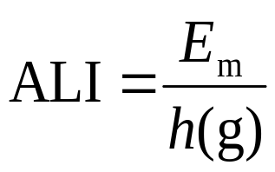
Annual limit of intake (ALI)
Legislation prescribes dose limits (E_{m}) that may be received by workers and members of the public per year
If we use these limits and dose coefficients, we can calculate activity (intake) that would result in a committed effective dose equal to E_{m}. This activity is called annual limit of intake, or ALI:
Notes:
Legislation lays down the dose limits, E_{m}, which may be received by workers or members of the public within a calendar year. Based on these dose limits we can use dose coefficients to determine the annual limit on intake (ALI) for a particular radionuclide.

Slide 116
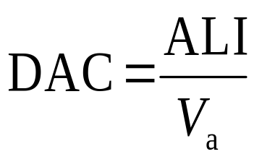
Derived air concentration (DAC)
Concentration of radionuclide in air that, if a worker breathed continuously for an entire working year (2000 hours and 1.2 m³/h breathing rate), would result in worker receiving a committed effective dose equal to annual dose limit
V_{a} = 1.2 m³/h·2000 h = 2400 m³
Notes:
The derived air concentration (DAC) is defined as the concentration of a given radionuclide in air (or in water or food – in this case it is called the derived concentration) at which the annual limit on intake for the radionuclide would be reached by inhalation (or drinking water or by dietary intake).
When working with sources of radiation, the greatest challenge is to prevent the intake of radionuclides into the body by inhalation, which means that in practice, derived concentrations are of key importance. They are calculated on the basis of the following premises:
a worker works 2000 hours a year,
the breathing rate is 1.2 m³ of air per hour.
The derived air concentration is thus:
DAC=ALI/V_{a}
where V_{a} is the volume of air breathed by a worker during working time and so V_{a} = 1.2 m³/h · 2000 h = 2400 m

Slide 117
DACs for occupationally exposed workers
radionuclide | DAC [Bq/m³]
Tritium | 460 000
Cobalt-60 | 290
Strontium-90 | 56
Iodine-131 | 1100
Cesium-137 | 1700
Plutonium-239 | 0.18

Slide 118
Exposure to radioactive noble gases
Radioactive noble gases do not enter human metabolism and do not contribute to committed effective dose
Inhaled and exhaled, resulting mainly in external exposure from radionuclides in ambient air
Dose can be calculated from air concentration and time of exposure
Noble gas radionuclide | t_{1/2} |  | Effective dose received in one day per unit of concentration in air [Sv d⁻¹ /Bq m⁻³]
Argon-41 | 1.83 | h | 5.3·10⁻⁹
Krypton-85 | 10.7 | y | 2.2·10⁻¹¹
Xenon-133 | 5.24 | d | 1.2·10⁻¹⁰
Xenon-135 | 9.1 | h | 9.6·10⁻¹⁰
Notes:
Radionuclides which are the radioisotopes of noble gases do not form chemical bonds with substances in the body, so they are not taken in by breathing or food, at least not in a significant degree. If present in air, they enter the lungs on inhalation and leave them on exhalation. Any dose is chiefly due to external radiation from noble gases in the ambient air. Since the received dose is independent of biological processes, it is relatively easy to calculate. It is usually given as the effective dose received in one day due to the presence of radioactive noble gases in the air. Its values are shown in table.

Slide 119
Protection against internal contamination
Best protection against internal exposure is to prevent (or control) the intake of radionuclides.
Restriction of open sources of radiation: Use of open sources should be restricted to a small number of designated areas
Control of areas containing open sources of radiation: Areas should be suitably designed and equipped. Controlled areas should have access control, suitable personal protective equipment at entrance and personal monitoring controls at exit
Notes:
Protection against internal exposure is based on the principles of defence in depth:
Restriction of open sources of radiation: Sources of radiation and processes which may cause radioactive contamination of surfaces or air should be restricted to a reasonably small number of designated areas.
Control of areas containing sources of radiation: Areas where work takes place should be suitably architecturally designed by selecting surface materials that facilitate effective decontamination and ensuring controlled outlets and good ventilation with air filtration. Where necessary (the requirements are laid down by legislation), work is carried out within a controlled area. Access to this area is physically controlled, only workers meeting certain requirements (personal protective equipment, training, etc.) are allowed to work in this area and appropriate equipment for personal contamination monitoring and decontamination should be available at the exit.

Slide 120
Protection against internal contamination (cont’d)
Preventing internal contamination by ingestion and absorption: Do not eat, drink, smoke or work with open cuts or wounds in radiation controlled areas
Personal protective equipment (PPE): Workers need to be trained in the use and are required to use PPE:
  Protective clothing prevents skin contamination
  Respiratory protective equipment restricts the intake of radioactive material by inhalation
  Other PPE (eye protection, hearing protection, fall protection, etc.) may be needed to protect against other hazards in the work area
Notes:
Preventing internal contamination by ingestion and absorption: While working in radiation controlled areas it is prohibited to eat, drink, smoke and work with open cuts or wounds.
Worker protection: Workers are required to use personal protective equipment. Its purpose is to prevent skin contamination (protective clothing) and – in cases of increased air contamination – to restrict the intake of radioactive material by inhalation (respiratory protective equipment).

Slide 121
Example: NPP basic protective equipment
This equipment should be provided at entrance to controlled area:
  a hard hat
  underwear
  cotton overalls
  cotton gloves
  protective shoes
  a set of personal dosimeters (a daily – electronic and a monthly – TLD/OSL dosimeter)
Notes:
Within the controlled area of a nuclear power plant, we always use basic protective equipment which (depending on the facility) consists of the following devices and clothes:
a hard hat,
underwear,
cotton overalls,
cotton gloves,
protective shoes,
a set of personal dosimeters (a daily – electronic and a monthly – TLD/OSL dosimeter).

Slide 122

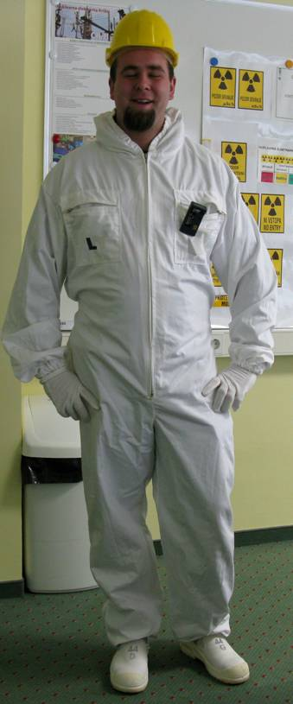
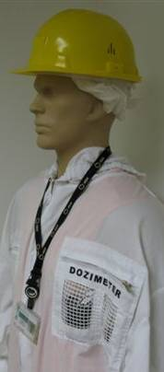
Example: NPP basic protective equipment (cont’d)
A worker wearing basic protective equipment (example)

Slide 123
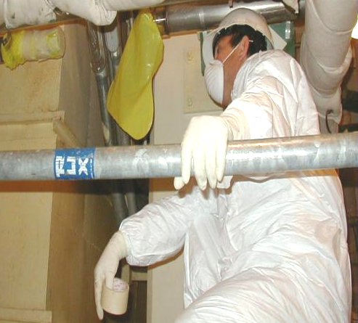
Additional protective equipment
In areas where surface or air contamination is probable or confirmed, additional protective equipment is also used according to the level of contamination
  Additional rubber gloves
  Shoe covers
  Tyvek coveralls
  Special protective clothing
  Respiratory protection
A worker in Tyvek coveralls with respiratory protection
Notes:
In areas where increased surface or air contamination is probable or confirmed, one or several pieces of additional protective equipment are also used according to the level of contamination:
additional rubber gloves,
shoe covers,
Tyvek coveralls,
special protective clothing,
a respirator,
a half mask,
a mask,
an air-supplied mask.

Slide 124
Respiratory protection
Reduces the inhalation of harmful airborne substances
However, respiratory protection hampers natural breathing and work performance
Workers carry out tasks 20 to 25% slower. In areas where external radiation is present, external exposure is increased. Decision on type and use of respiratory protection should be based on ALARA
Working while using respiratory protection increases the load on heart and lungs. Workers who are likely to use respirators should undergo a special medical examination
Notes:
The basic aim of any type of breathing apparatus or respirator is to effectively reduce the inhalation of airborne substances which are harmful to health into the lungs. Since breathing equipment to a certain extent hampers natural breathing and/or the performance of work operations, decisions on the use of breathing equipment should be made in the knowledge that:
Workers wearing a respirator carry out a given task 20 to 25 % more slowly than they would without a respirator. In an area where external radiation and air contamination are present, the decision should comply with the ALARA principle to minimize the sum of the external and internal dose.
Working with breathing equipment increases the load on the heart and lungs. For this reason all workers who are likely to use respirators must undergo a special additional medical examination.

Slide 125
Respiratory protection (cont’d)
Three main groups:
  air-purifying respirators (air filtration),
  air-line respirators (clean air supplied via hose)
  Self-contained breathing apparatus
Air-purifying respirators are able to reduce the concentration of radionuclides bound to airborne dust particles or particulates (and some organic vapours)
Respirators supplying clean air will also reduce the concentration of radionuclides in the gaseous state
Notes:
Respiratory equipment falls into three main groups (Table on the next slide):
air-purifying respirators (air filtration),
air-line respirators (with clean air supplied via a hose),
self-contained breathing apparatus.
Air-purifying respirators are able to reduce the concentration only of radionuclides bound to airborne dust particles or particulates (and some organic vapours), whereas respirators supplying clean air will also reduce the concentration of radionuclides in the gaseous state. The respirator’s protection factor (PF) tells us by how much the concentration of activity in the inhaled air is lower than its concentration in ambient air:
ac_{inhaled air}=ac_{ambient}/PF

Slide 126
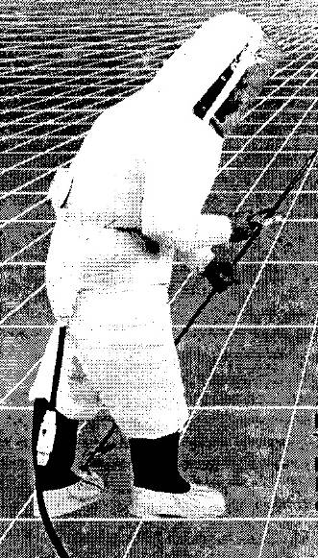
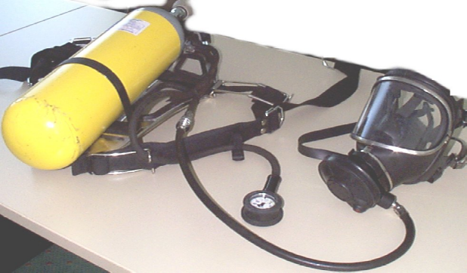
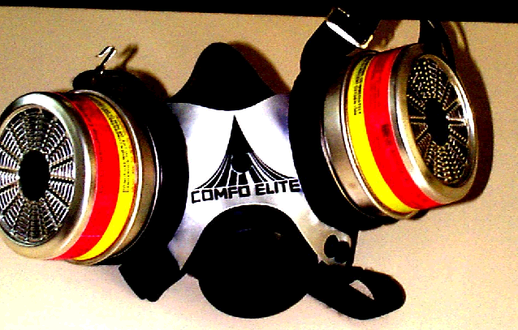
Respiratory protection (cont’d)
A typical requirement is that the concentration of activity in inhaled air is less than 0.1 DAC
Protection factor (PF) tells us by how much the concentration of activity in the inhaled air is lower than its concentration in ambient air
Self-contained breathing apparatus
Filter half mask
Protective clothing (suit) with an air line

Slide 127
Characteristics of respiratory equipment
type | shape | principle of operation | PF particles only | PF particles and gases
air filtration | half facepiece | negative pressure during inhalation | 10
 | full facepiece | negative pressure during inhalation | 50
 | full facepiece | positive pressure | 1000
air-line | half facepiece | continuous air flow |  | 1000
 | half facepiece | flow during inhalation |  | 10
 | full facepiece | continuous air flow |  | 2000
 | full facepiece | flow during inhalation |  | 50
 | full facepiece | positive pressure, flow during inhalation |  | 2000
 | suit | continuous air flow |  | 2000
self-contained breathing apparatus | full facepiece | flow during inhalation |  | 50
 | full facepiece | positive pressure, flow during inhalation |  | 10000
 | full facepiece | closed-circuit breathing |  | 50
 | full facepiece | closed-circuit breathing, positive pressure |  | 5000

Slide 128
Radiation protection regulations

Slide 129
Learning objectives
Explain the basic ICRP principles
Explain the concept of ALARA
Explain the key contents of the BSS

Slide 130
Aim of radiation protection
Fundamental principle of radiation protection: exposure is justified only when the benefit derived from using a source is greater than the risk associated with exposure
Radiation protection provides standards of protection for use of sources that are considered safe, considering other risks encountered in society
Notes:
People enjoy great benefits from the application of X-radiation, radionuclides and nuclear fuel in medicine, industry, research and electricity generation. However, working with sources of radiation by necessity implies a certain exposure of people to radiation, both during normal use and in potential accidents which no human activity is immune to. Under the assumption that any exposure of an individual to radiation poses a certain risk, exposure is only justified when the benefit derived from using a source is greater than this risk. Thus the fundamental principle of radiation protection is to assess the risks and benefits brought by the use of radiation. If the restrictions imposed on the use of radiations are too mild, the risks are unacceptably great; if the restrictions are too severe, the use of sources becomes too complicated or too expensive, depriving us of the benefits it could bring.
A simple example of assessing the positive and negative outcomes of using radiation is found in health care: a patient receives (compared to exposure in other activities) a relatively large dose, but the benefit of a radiological scan or therapy for the patient is greater than the radiation risk. Of course we should bear in mind that apart from the patients, exposure also affects health workers, although in a lesser degree. So it is also important to assess the benefit or risk brought by the use of radiation to society at large. The situation with radiation in nuclear power plants is similar. We know that nuclear power plants are very efficient and environmentally friendly energy facilities, and yet their operation unavoidably involves – relatively low, but nonetheless – exposure of workers to radiation, minimal discharges of radioactive substances, etc. This makes the question of benefits and risks a rather complex one which can only be answered by society as a whole. Even in traffic where the risks are very obvious as well as easily proved, there are rules that strike a balance between benefits and risks: no doubt there would be fewer accidents if e.g. the speed limit on motorways was 30 km/h, but the general assessment the risk with a limit of 130 km/h is still acceptable and, at the same time, the benefit of faster-moving traffic is much greater than the increased risk of higher speeds.

Slide 131
International recommendations and standards
Non-governmental organizations:
  International Commission on Radiological Protection (ICRP) issues recommendations on radiation protection
  International Commission on Radiation Units and Measurements (ICRU) provides standards for radiation units and measurements
International organizations:
  United Nations Scientific Committee on the Effects of Atomic Radiation (UNSCEAR) mostly deals with studies of radiation effects
  International Atomic Energy Agency (IAEA) issues safety standards that are aligned with ICRP recommendations
Notes:
There are many international bodies and organisations around the world that study the effects of radiation and issue recommendations on radiation protection. They can be grouped into governmental and non-governmental organisations, or as those issuing merely non-binding recommendations and those international organisations which also have legislative power over their member states.
Non-governmental organisations include the ICRP and ICRU, which award membership to distinguished scientists based on their professional accomplishments.
International organisations which are either partly or fully focused on the issues of radiation protection and safety include the IAEA (International Atomic Energy Agency), the UNSCEAR (United Nations Scientific Committee on the Effects of Atomic Radiation), as well as the European Commission (EC). The UNSCEAR mostly deals with epidemiological studies of radiation effects and the IAEA issues safety standards which are aligned with ICRP recommendations and indirectly binding on member states (non-compliance leads e.g. to a withdrawal of IAEA’s technical support). On the other hand, EU directives are mandatory for member states.

Slide 132
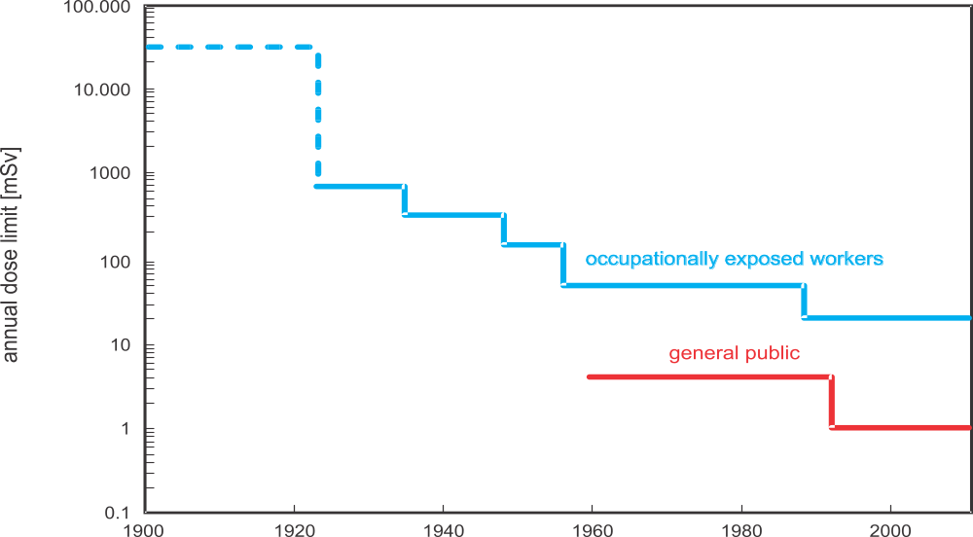
ICRP recommendations
Using available data, ICRP provides recommendations regarding dose limits for occupationally exposed workers and members of the public
Notes:
The ICRP is an independent, non-governmental professional body operating since 1928 and its primary goal is to issue recommendations on radiation protection.
As new findings about the effects of exposure to radiation came to light over the years, the ICRP repeatedly lowered the recommended annual dose limit

Slide 133
ICRP recommendations (cont’d)
Data from Hiroshima and Nagasaki survivors confirm that the probability of developing radiation-induced cancer is proportional to dose received
To be conservative, ICRP uses the linear no-threshold model, which assumes that even low doses may cause harm
Principles of radiation protection:
  Justification
  Optimization
  Dose limits
Notes:
Data on the increased number of cancerous diseases in atomic bomb victims clearly showed that, at high doses, the probability of developing radiation-induced cancer is proportional to the dose received. At low doses, the probability is so small that radiation-induced cancer cannot be statistically proved. However, there is also no firm evidence that sufficiently low doses are harmless, so the ICRP adopted the conservative hypothesis of the linear dependence of the probability of stochastic effects with no threshold (the linear no-threshold model – LNT). This lead to a change in the overall concept of radiation protection: rather than compliance with the highest allowed doses, its goal is to reduce the probability of stochastic effects in the entire population, whether workers or inhabitants, to the lowest reasonable level.
The ICRP system of limiting radiation exposure is based on three principles:
justification,
optimization,
dose limits.

Slide 134
ICRP recommendations (cont’d)
Justification: Sources of radiation be used only for those activities which bring more benefit than harm due to exposure to radiation
Optimization: All exposures be kept as low as reasonably achievable, economic and social factors being taken into account (ALARA)
Dose limits: Values of effective dose or equivalent that should not be exceeded

Slide 135
IAEA Basic Safety Standards (BSS)
IAEA Safety Standards Series GSR Part 3: Radiation Protection and Safety of Radiation Sources: International Basic Safety Standards
Published in 2014
Based on ICRP recommendations and UNSCEAR findings
Jointly sponsored by a number of international organizations
Notes:
The findings of the UNSCEAR and the recommendations of international expert bodies, notably the ICRP, are taken into account in developing the IAEA safety standards.
The preparation and review of the IAEA safety standards involves its own Secretariat and four safety standards committees for safety in the areas of nuclear safety (NUSSC), radiation safety (RASSC), the safety of radioactive waste (WASSC) and the safe transport of radioactive material (TRANSSC), and a Commission on Safety Standards (CSS) which oversees the programme for their development.
The principal users of IAEA safety standards in the member states are regulatory bodies and other relevant national authorities. All IAEA member states may nominate experts for the IAEA safety standards committees and may provide comments on draft standards. The CSS membership is appointed by the IAEA Director General and includes senior governmental officials having responsibility for establishing national regulations. A management system has been established for the processes of planning, developing, reviewing, revising and establishing the IAEA safety standards. It articulates the mandate of the IAEA, its vision on the future application of the IAEA safety standards, policies and strategies, and corresponding functions and responsibilities.
As indicated above, the ICRP is the main body which makes recommendations with respect to radiological protection matters in general, and dose limits in particular. For this reason, the IAEA has embodied the ICRP recommendations (i.e., those in its publication number 103 of 2007) in the latest publication of the Basic Safety Standards (Radiation Protection and Safety of Radiation Sources: International Basic Safety Standards, Interim Edition, General Safety Requirements Part 3, No. GSR Part 3 of 2011, hereafter referred to as BSS).

Slide 136
BSS (cont’d)
Requirements regarding:
  Basic obligations and administrative requirements for practices, dose limits, management, technical and safety verification
  Occupational exposure, public exposure, emergency exposure situations (including interventions)
  Protection of the environment
  Interface between safety and security
Other publications in the IAEA Safety Standards Series provide additional guidance on how to meet BSS requirements
Notes:
The BSS specify basic obligations and administrative requirements for practices, dose limits (in accordance with the ICRP recommendations) and relevant radiation protection, management, technical and safety verification requirements.
They also lay down detailed requirements for occupational exposure, public exposure, emergency exposure situations (including interventions), and also specify other exposures (potential, medical) to ionizing radiation. BSS also identify the protection of the environment as an issue necessitating assessment and the necessity of designing and implementing security and radiation safety measures in an integrated manner so that they do not conflict with each other.
Other publications of the IAEA safety standards series give more detailed guidance on how the BSS requirements should be met in particular situations. In this respect, Table 8.1 in textbook shows the current most relevant IAEA safety standards which can be used for achieving an appropriate level of safety and regulation of installations/facilities in the nuclear fuel cycle

Slide 137
Types of exposure situations
Planned exposure: Arises from a planned operation of a source or from a planned activity that results in an exposure
Emergency exposure: Arises as a result of an accident, a malicious act, or any other unexpected event, and requires prompt action to avoid or to reduce adverse consequences
Existing exposure: Already exists when decision on need for control is taken. Includes exposure to natural background radiation, exposure due to residual radioactive material from past practices, or that remains after an emergency exposure situation
Notes:
For the purpose of establishing practical requirements for protection and safety, the standards distinguish between three different types of exposure situations: planned exposure situations, emergency exposure situations and existing exposure situations:
A planned exposure situation is a situation of exposure that arises from the planned operation of a source or from a planned activity that results in an exposure from a source. Since provision for protection and safety can be made before embarking on the activity concerned, the associated exposures and their likelihood of occurrence can be restricted from the outset.
An emergency exposure situation is a situation of exposure that arises as a result of an accident, a malicious act, or any other unexpected event, and requires prompt action in order to avoid or to reduce adverse consequences. Preventive actions and mitigatory actions have to be considered before an emergency exposure situation arises.
An existing exposure situation is a situation of exposure which already exists when a decision on the need for control has to be taken. Existing exposure situations include situations of exposure to natural background radiation. They also include situations of exposure due to residual radioactive material that derives from past practices that were not subject to regulatory control or that remains after an emergency exposure situation.

Slide 138
Dose limits for planned exposure situations
For occupational exposure of workers
  Effective dose of 20 mSv per year averaged over five consecutive years (100 mSv in five years), and of 50 mSv in any single year
  Equivalent dose to lens of the eye of 20 mSv per year averaged over five consecutive years (100 mSv in five years) and of 50 mSv in any single year
  Equivalent dose to extremities (hands and feet) or skin of 500 mSv in a year
  Additional restrictions for pregnant or breast-feeding workers
Notes:
For planned exposure situations, the following dose limits are set:
For occupational exposure of workers over the age of 18 years, the dose limits are:
(a) An effective dose of 20 mSv per year averaged over five consecutive years (100 mSv in 5 years), and of 50 mSv in any single year;
(b) An equivalent dose to the lens of the eye of 20 mSv per year averaged over 5 consecutive years (100 mSv in 5 years) and of 50 mSv in any single year;
(c) An equivalent dose to the extremities (hands and feet) or the skin of 500 mSv in a year.
Additional restrictions apply to occupational exposure for a female worker who has notified pregnancy or is breast-feeding.

Slide 139
Dose limits for planned exposure situations (cont’d)
For members of the public
  Effective dose of 1 mSv* in a year
  Equivalent dose to lens of eye of 15 mSv in a year
  Equivalent dose to skin of 50 mSv in a year
*in special circumstances, a higher value of effective dose in a single year could apply, provided that the average effective dose over five consecutive years does not exceed 1 mSv per year
Notes:
For public exposure, the dose limits are:
(a) An effective dose of 1 mSv in a year;
(b) In special circumstances, a higher value of effective dose in a single year could apply, provided that the average effective dose over five consecutive years does not exceed 1 mSv per year;
(c) An equivalent dose to the lens of the eye of 15 mSv in a year;
(d) An equivalent dose to the skin of 50 mSv in a year.

Slide 140
Dose limits for emergency situations
BSS specifies generic criteria for acute doses for which protective actions and other response actions should be undertaken to avoid or to minimize severe deterministic effects
BSS sets guidance levels for restricting the exposure of emergency workers
Notes:
For emergency situations, the Safety Standards specify generic criteria for acute doses for which protective actions and other response actions are expected to be undertaken under every circumstance to avoid or to minimize severe deterministic effects, and also sets guidance levels for restricting the exposure of emergency workers.

Slide 141
Employer and licensee responsibilities
Be responsible for the protection of workers against occupational exposure
Ensure that protection is optimized and that dose limits are not exceeded
Establish and maintain arrangements for designation of controlled areas, for local rules and for workplace monitoring
Establish, maintain and keep under review a programme for workplace monitoring under the supervision of qualified expert
Notes:
In BSS a number of requirements for government, regulatory bodies, registrants (registered users) and licensees, employers and workers are stated. We list some requirements related to the responsibilities of employers, registrants and licensees regarding protection of workers:
Employers, registrants and licensees shall be responsible for the protection of workers against occupational exposure. Employers, registrants and licensees shall ensure that protection and safety is optimized and that the dose limits for occupational exposure are not exceeded.
Employers, registrants and licensees shall establish and maintain organizational, procedural and technical arrangements for the designation of controlled and supervised areas, for local rules and for monitoring of the workplace, in a radiation protection programme for occupational exposure.
Registrants and licensees, in cooperation with employers where appropriate, shall establish, maintain and keep under review a programme for workplace monitoring under the supervision of a radiation protection officer or qualified expert.

Slide 142
Employer and licensee responsibilities (cont’d)
Be responsible for making arrangements for assessment and recording of occupational exposure and for workers’ health surveillance
Provide workers with adequate information, instruction, training and protective equipment
Not offer benefits as substitutes for protection and safety measures
Make special arrangements for female workers to protect embryo or foetus and breast-fed infants
Notes:
Employers, registrants and licensees shall be responsible for making arrangements for the assessment and recording of occupational exposure and for workers’ health surveillance.
Employers, registrants and licensees shall provide workers with adequate information, instruction and training for protection and safety.
Employers, registrants and licensees shall not offer benefits as substitutes for measures for protection and safety.
Employers, registrants and licensees shall make special arrangements for female workers, as necessary, for protection of the embryo or foetus and of breast-fed infants. Employers, registrants and licensees shall make special arrangements for the protection and safety of persons under 18 years of age who are undergoing training.

Slide 143
Other BSS requirements (cont’d)
Provides criteria for exemption of practices and sources and for clearance of sources
Requires a graded approach: the application of the BSS shall be commensurate with characteristics of the practice or the source, and with the magnitude and likelihood of exposures
Notes:
The requirements for a legal and regulatory framework are supported by optimised criteria for exemption of practices and sources and by criteria for clearance of sources. The exemption level is a value established by a regulatory body and expressed in terms of activity concentration, total activity, dose rate or radiation energy, at or below which a source of radiation need not be subject to some or all aspects of regulatory control. The clearance level is a value established by a regulatory body and expressed in terms of activity concentration, at or below which regulatory control may be removed from a source of radiation within a notified or authorized practice.
A general requirement related to all aspects of radiation protection and safety is the requirement for a graded approach: the application of the Standards shall be commensurate with the characteristics of the practice or the source within a practice, and with the magnitude and likelihood of exposures.

Slide 144
Question for discussion
In an emergency situation, a worker wants to volunteer to enter an area with very high radiation fields in order to secure the situation. You are responsible for deciding whether to allow this.
What factors would you consider to guide you in your decision?
Notes:
What is the likelihood that the person’s actions would be successful?
Is the person a true volunteer?
Does the person understand the consequences?
What are the alternatives?
What measures can be taken to reduce the risk?
How quickly must action be taken?
etc

Slide 145
Exercise #4
An industrial radiography source (gamma) has a measured dose rate of 15 mSv/h at 5 m.
  What would the dose rate be at 10 m, 1 m, and 0.1 m?
  At what distance would the dose rate be 10 µSv/h?
  At 10 m, how long would it take to exceed an effective dose of 5 mSv?
  For an occupational exposed worker, how long would it take to exceed annual effective dose limit at 1 m?
Notes:
If time is short, divide the participants into groups and have each group answer one question

Slide 146
Radiation protection in nuclear installations

Slide 147
Learning objectives
List typical annual doses for workers in nuclear facilities
List typical annual doses for the general population around nuclear facilities
Name the main families of radionuclides in a nuclear reactor and describe how they are formed

Slide 148
Aspects of radiation protection in the nuclear fuel cycle
Nuclear fuel cycle contains broad range of nuclear installations to process uranium, plutonium and thorium
  UNSCEAR data for 800,000 workers: collective dose 1,400 person·Sv and average annual effective dose just over 1 mSv
  Doses are declining
Stage of nuclear fuel cycle | Dose (mSv)
Uranium mining | 4.5
Uranium milling | 3.3
Enrichment | 0.1
Fuel fabrication | 1.0
Nuclear reactors | 1.4
Reprocessing | 1.5
Annual effective doses in the nuclear industry
Notes:
The nuclear fuel cycle contains a broad range of nuclear installations that employ a variety of technologies to process and utilize uranium, thorium and plutonium. These nuclear installations mainly include facilities for mining and milling, conversion, enrichment, fuel fabrication (including mixed oxide fuel - MOX), power and research reactors, interim spent fuel storage, reprocessing, waste disposal, and vitrification. Transportation systems are also recognized as an integral link between nuclear installations.
UNSCEAR has compiled data on doses received by about 800,000 workers in the nuclear industry worldwide. In accordance with these estimates, the collective dose is about 1,400 man Sv and the average annual effective dose tends to be a little higher than 1 mSv. Nevertheless, doses have declined steeply in the last decade because of the widespread introduction of ICRP recommendations and the IAEA radiation safety standards (e.g. the BSS). Table 9.1 shows the UNSCEAR estimates of the average annual effective doses in relation to different occupations in the nuclear industry.

Slide 149
Aspects of radiation protection in the nuclear fuel cycle (cont’d)
At each stage of nuclear fuel cycle, variety of radionuclides are released in environment as liquids, gases or solid effluents
During normal operation, releases are low and doses to public must be estimated by models (annual doses are generally less than 1 µSv)
UNSCEAR estimate:
  collective dose ~0.9 person-Sv per Gwy
  225 person·Sv for total annual production 250 GWy
Notes:
At each stage of the nuclear fuel cycle, a variety of radionuclides are released into the environment in the form of liquids, gases or solid effluents, whose characteristics depend on the particular operation or process. During the routine operation of nuclear installations, for instance, releases of radionuclides are low and normally exposures to the public have to be estimated by environmental transfer models.
For all nuclear fuel cycle operations (including mining and milling, fuel fabrication, reactor operation, fuel reprocessing and waste management), the local and regional exposures are estimated by UNSCEAR to be about 0.9 man-Sv per gigawatt-year (GWy). The present world nuclear energy generation is about 250 GWy, so that the total collective dose from a year’s nuclear generation is about 225 man‑Sv. Generally individual doses are low, being below 1 μSv in a year. However, certain individuals might receive higher doses because of where they live and what they eat and these should be subject to dose constraints. table 9.2 shows the annual doses due to discharges from the nuclear fuel cycle.

Slide 150
Important radionuclides for radiation protection
In power and research reactors fission takes place. During reactor operation, reactor core is the main source of neutrons and gamma radiation. Fission products from fuel are highly radioactive, also activated construction materials and activated corrosion products
In reprocessing and/or waste management, storage and disposal facilities, all types of radionuclides (fission products, activation products, actinides) are important for radiation protection
Notes:
Nuclear reactors are devices where the fission chain reaction takes place. The reactor core is therefore the main source of radiation during reactor operation. It is a very strong source of neutrons and fission products. Fission products are very highly radioactive while in the construction elements of the reactor neutrons produce additional sources of radioactivity, the so-called activation or corrosion products.
Nuclear reactors can be divided into power reactors (nuclear power plants) and research reactors. As power reactors generally have significantly higher power than research reactors, the amount of radioactivity produced is usually much larger than in the case of research reactors. However, the radiation protection issues are at least in principle similar for both types of reactors. Naturally, as NPPs are much more complex installations than research reactors, the radiation protection problems are also much more complex.
In the back end of the nuclear fuel cycle (reprocessing and/or waste management, storage and disposal), all types of radionuclides (fission products, activation products, actinides) are important for radiation protection. As reprocessing or waste disposal usually takes place some time after the waste has been removed from the reactor and power plant systems, only the long-lived radionuclides (with half-lives comparable or greater than the time since removal from the of reactor) are of importance.

Slide 151
Natural radionuclides
Radon-222 and its progeny are largest contributors to exposure from natural sources (1.2 mSv of 2.4 mSv per year, world average)
In uranium mines and milling facilities, radon concentration is substantially higher; special measures are needed to protect workers and the neighbouring population
Notes:
Radon therefore presents the largest radiation risk from natural radioactivity and, in fact, contributes one half of the average natural dose of population (1.2 mSv of 2.4 mSv total). A list of important radon daughter radionuclides with their properties is given in table.
In uranium mines and milling facilities, the concentration of radon is substantially higher than the average natural background, therefore special measures need to be taken to protect the workers and the population in the neighbourhood of these facilities. These measures include ventilation and respiratory equipment.

Slide 152
Fission products
During operation, total activity of a single fuel element is more than 10¹⁸ Bq; one month after shutdown ~10¹⁷ Bq; and after 10 years in the spent fuel pool ~10¹⁶ Bq
Most fission products are
chemically bound in uranium
dioxide. Fuel pellet is first
barrier to preventing spread of
radioactive materials
Nuclide | t_{1/2} | E_{γ} [MeV] | E_{β,max} [MeV]
^{85m}Kr | 4.48 h | 0.151
¹³³Xe | 5.25 d | 0.081
¹³⁵Xe | 9.10 h | 0.250
¹³¹I | 8.02 d | 0.364; 0.637
¹³⁷Cs | 30.2 y | 0.662
⁹⁰Sr/⁹⁰Y | 28.6 y | - | 2.3
³H | 12.3 y | - | 0.02
Notes:
Fission products are a direct product of fission. They are produced within the reactor fuel and have by far the greatest activity of all radionuclides in the reactor or the nuclear power plant. During reactor operation or immediately after its shutdown, the total activity of a single fuel element is higher than 10¹⁸ Bq, a month after shutdown it is around 10¹⁷ Bq and after 10 years in the spent fuel pit it is around 10¹⁶ Bq. Fortunately most fission products are elements which remain chemically bound in uranium dioxide and are consequently not released from the fuel pellet. In the context of nuclear safety, the pellet is thus considered as the first barrier that prevents the dispersal of radioactive materials.
In table, major fission products with the main γ lines (they all emit β particles as well, but β energies are only given for pure beta emitters).

Slide 153
Fission products (cont’d)
Gaseous and volatile fission products can escape from the pellet and build up in space between pellet and fuel cladding
Fuel cladding is the second barrier
Power reactor core contains 20,000 to 50,000 fuel rods and few, if any, experience cladding failure
Some fission products (particularly tritium and noble gases) can diffuse through the cladding. Therefore, reactor coolant will contain some fission products
Notes:
It is particularly the noble gases (Kr and Xe isotopes; practically entirely) which escape or diffuse out of the fuel pellet, as well as the isotopes of volatile elements (I, Cs, Sr, tritium; the bulk of the inventory). The pellet also partly releases the isotopes of Ba, Ce and Ru/Rh. The radionuclides which escape from the pellet build up in the empty space between the pellets and the fuel rod cladding, i.e. in the gap and plenum. The cladding is the second barrier to the dispersal of radioactive materials.
A PWR reactor core contains from 20,000 to 50,000 fuel rods and in a very small fraction of them the cladding does not stay perfectly tight throughout the service life. Some fission products (tritium and the noble gases in particular) even diffuse through the cladding. For this reason, a fraction of the fission products passes into the reactor coolant. ¹³³Xe has the greatest activity of all fission product listed in table on previous slide (Table 9.4 in textbook).

Slide 154
Activation and corrosion products
Fission neutrons activate materials in and surrounding the core: coolant and reactor components
Corrosion and erosion products are brought into reactor core by reactor coolant and can also be activated
Nuclide | t_{1/2} | formation | E_{γ} [MeV]
¹⁶N | 7.1 s | ¹⁶O (n, p) ¹⁶N | 6.13; 7.12
⁴¹Ar | 1.83 h | ⁴⁰Ar (n, γ) ⁴¹Ar | 1.29
⁵¹Cr | 27.7 d | ⁵⁰Cr (n, γ) ⁵¹Cr | 0.32
⁵⁴Mn | 312 d | ⁵⁴Fe (n, p) ⁵⁴Mn | 0.835
⁵⁸Co | 70.8 d | ⁵⁸Ni (n, p) ⁵⁸Co | 0.811
⁵⁹Fe | 44.5 d | ⁵⁸Fe (n, γ) ⁵⁹Fe | 1.099; 1.292
⁶⁰Co | 5.27 y | ⁵⁹Co (n, γ) ⁶⁰Co | 1.332; 1.173
Notes:
Neutrons also activate other materials in the core or its immediate environment: the coolant and the construction materials of the reactor. Such radionuclides are called activation products. The coolant that flows through the primary circuit (reactor, hot leg, steam generator, cold leg, reactor pump) causes corrosion and erosion processes on the walls of the primary circuit and on the construction elements of the core. As a result, tiny particles of these materials pass into the coolant and are activated as they travel through the core. Such radionuclides are called corrosion products.
In table (Table 9.5 in textbook) major activation and corrosion products with the main γ energies (they all emit β⁻ as well) are given.

Slide 155
Activation and corrosion products (cont’d)
During normal operation, activation and corrosion radionuclides are spread throughout the primary circuit. Some remain in the coolant, but some will eventually bind to the inner walls of primary system
Pressure boundary of primary system is the third barrier to the dispersal of radioactive material
Notes:
Except in some special cases (working in the proximity of the reactor vessel, decommissioning) the most important activation products in terms of radiation protection are the radionuclides spread by the coolant through the primary circuit. These are either nuclides which form directly in the coolant or activated materials of e.g. the reactor vessel wall or core construction elements which enter the coolant due to erosion and/or corrosion. In nature, such material is not much different from the material entering the coolant by erosion-corrosion from other parts of the primary circuit, except that the materials may differ (the pressure vessel is made of steel and e.g. the steam generator tubes of nickel alloy). Activation and corrosion products are therefore discussed collectively. They typically spread throughout the entire primary system via the coolant and eventually a part of them binds to the inner walls of the pressure boundary. This process causes the contamination of all primary system components.
Besides activation and corrosion products, fission products are also released in the coolant. The pressure boundary of the primary circuit is thus the third barrier to the dispersal of radioactive materials. Table on previous slide (Table 9.5 in textbook) gives the major activation and corrosion products.

Slide 156
Activation and corrosion products (cont’d)
The most important source of radiation in the coolant during reactor operation is Nitrogen-16, formed by fast neutron reaction on oxygen
Nitrogen-16 emits highly penetrating gamma radiation
Argon is present in air (1%) and is activated (Argon-41) in hollow spaces adjacent to the reactor vessel
Notes:
Among activation products also the gases nitrogen in argon are listed. Nitrogen-16 is formed by fast neutron reaction on oxygen in water molecules. It emits highly penetrating gamma radiation and is the most important source of radiation in the coolant during reactor operation. Argon is a component of air (its fraction in air is about 1%) and it is mostly formed in hollow spaces adjacent to the reactor vessel. In pool-type research reactors, air is present dissolved in the coolant and ⁴¹Ar accounts for the largest part of the activity released.

Slide 157
Hot particles
During maintenance, tiny particles could be released into primary system
Subsequently, these tiny particles are activated in reactor core
These small, mobile and highly radioactive particles are called hot particles
Hot particles can produce high local doses if they attach to skin, or if inhaled
Notes:
The maintenance of pumps, valves and piping involves techniques such as cutting, grinding and welding which may produce tiny fragments that are carried away by the coolant. Often too small to be retained by filters, they are activated as they pass though the core. A similar thing happens to fragments resulting from the presence of foreign bodies in the primary system, which travel in water and cause damage to the walls and inner surfaces of primary system components. This results in microscopically small solid particles with high specific activity which are called hot particles.
Hot particles may contain a single radionuclide or a large number of radionuclides. These nuclides can be fission, activation or corrosion products. Exposure to hot particles is particularly significant in cases of a hot particle landing on the bare skin or protective clothing of workers, or their inhalation.

Slide 158
Exercise #5
A valve on a primary system sampling line is leaking.
  What radionuclides you would expect to be measured in the air near the leak?
  What radionuclides would you expect in the leaking primary water?
  The valve was changed during an outage. Before transport to decontamination facility, removable contamination on the valve was measured. What radionuclides you would expect to be detected?

Slide 159
Protection of the environment

Slide 160
Learning objectives
Describe the main exposure pathways for members of the public
Explain the objectives of monitoring
Explain the term “representative person”
Explain dose assessment approaches for members of the public

Slide 161
Need for monitoring nuclear facilities
Almost all waste radioactive material is collected in the NPP, however waste processing technology cannot, at reasonable cost, retain all radioactive material
Small quantities of radioactive liquids and/or gases are discharged into environment
These discharges contribute to additional exposure of the public, particularly near the NPP
Notes:
In the current state of technology, the operation of nuclear and some radiation facilities would not be possible without some radioactive release to the environment. Almost all waste radioactive material is collected, treated and stored in the form of High Level Waste (HLW) or Low and Intermediate Level Waste (LILW), but waste processing technology cannot retain all the radioactive content within the facility boundaries, at least not at acceptable costs. Therefore small quantities of low specific activity liquids and/or gases are discharged into the environment. The consequence of these discharges is additional exposure of the population, primarily in the vicinity of the facility.

Slide 162
Need for monitoring nuclear facilities (cont’d)
During normal operation discharges are subject to regulatory control: they must be authorized and monitored
  Monitoring is generally carried out by owner or licensee, but some regulatory bodies conduct independent monitoring
During emergency situations, releases that exceed normal operation values may occur
  Monitoring should be capable of assessing these releases and associated dose rates to support effective and timely emergency response
Notes:
During normal operation discharges are subject to statutory control: they must be authorised and monitored. Regular monitoring of these controlled discharges, both at the source of the discharge and in the receiving environment, is essential in ensuring the protection of the public and the environment. Monitoring is generally carried out by the owners of nuclear and radiation facilities, and in some cases by regulatory agencies.
Remark:
In radiation and nuclear safety the meaning of noun “monitoring” is not limited to the functions that have just been mentioned. According to International Basic Safety Standards [8], monitoring is “the measurement of dose, dose rate or activity related to the assessment or control of exposure to radiation or radioactive substances, and the interpretation of the results.” Depending on where the measurements are made, it could be classed as individual (personal) monitoring, workplace monitoring, source monitoring and environmental monitoring. Depending on the purpose, it could be routine monitoring, task related monitoring and special monitoring.
During emergency situations releases are possible which highly exceed values in normal operation. While these releases will probably be uncontrolled, monitoring should be capable of assessing such elevated dose rates and activities in the environment to support an effective and timely emergency response.

Slide 163
Exposure pathways to the population
Controlled gaseous releases consist of a mixture of gases, vapours and particulates usually discharged through a stack or discharge vents
Controlled liquid releases are typically contaminated water discharged via pipelines into rivers, lakes or the sea
Gaseous releases:
  spread in the form of a radioactive cloud
  Deposit some radioactive content on ground and vegetation (fallout)
Notes:
Controlled gaseous releases from nuclear facilities consist of a mixture of gases, vapours and particulates containing radionuclides which are usually discharged through the stack, although for small facilities they may be made through discharge vents or working hoods. Controlled liquid releases are typically contaminated water discharged via pipelines into rivers, lakes or the sea.
Gaseous releases spread in the form of a radioactive cloud, but a part of its radioactive content is also deposited on the ground and vegetation. This effect, called fallout, is enhanced with precipitation. Radionuclides from liquid discharge mix with water bodies and also in groundwater. Irrigation spreads these radionuclides to soil on cultivated land.

Slide 164
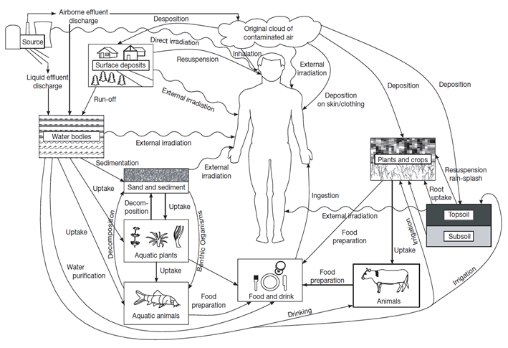
Exposure pathways to the population (cont’d)

Slide 165
Exposure pathways to the population (cont’d)
Importance of various exposure pathways depends on:
  Radiological, physical and chemical properties of material
  Dispersal mechanism and environmental characteristics
  Locations, ages, diets and habits of exposed population
Each NPP must identify and evaluate important exposure pathways during licensing process
Licensing process will then prescribe limits for discharges based on dose limits for the public
Notes:
The importance of the various exposure pathways depends on:
The radiological properties of the material released (e.g. gamma, beta or alpha emitters; physical half-life);
The physical (e.g. gas, liquid or solid) and chemical (e.g. organic or inorganic form, oxidation state, speciation, etc.) properties of the material and its migration characteristics;
The dispersal mechanism and factors affecting it (e.g. stack height, meteorological conditions, etc.) and environmental characteristics (e.g. climate, type of biota, agricultural production, etc.);
The locations, ages, diets and habits of the exposed individuals or population.
As can be seen, the importance of each exposure pathway depends on the source properties, and the environmental and population characteristics. Therefore important exposure pathways must be identified and evaluated for each nuclear facility.
For all nuclear and radiation facilities identification and evaluation of exposure pathways must be done during the licensing process, when limits for discharges and dose constraint for public exposure are also laid down according to national legislation.
Constraint [8]:
A prospective and source-related value of individual dose (dose constraint) or risk (risk constraint) that is used in planned exposure situations as a parameter for the optimization of protection and safety for the source, and which serves as a boundary in defining the range of options in optimization.
For public exposure, the dose constraint is a source-related value established or approved by the government or the regulatory body, with account taken of the doses from planned operations of all sources under control. The dose constraint for each particular source is intended, among other things, to ensure that the sum of doses from planned operations for all sources under control remains within the dose limit.
Simply put, the dose constraint is the dose limit for members of the public related to a particular facility or source. Usually, dose constraints for nuclear facilities are from 0.1 mSv to 0.3 mSv per year.

Slide 166
Objectives of monitoring
Verify compliance with authorized discharge limits and any other regulatory requirements
Provide data to assess the exposure or potential exposure of the public from the normal operation, and from accidents or past activities
Confirm adequacy of controls on discharges and to provide early warning of unusual or unforeseen conditions
Notes:
The main objective of monitoring is verifying compliance with the requirements for protection and safety. As specified in IAEA Safety Standards [16], the primary objectives of any monitoring programme for protection of the public and the environment are to:
Verify compliance with authorized discharge limits and any other regulatory requirements concerning the impact on the public and the environment due to the normal operation of a practice or a source within a practice;
Provide information and data for dose assessment purposes, and to assess the exposure or potential exposure of populations due to the presence of radioactive materials or radiation fields in the environment from the normal operation of a practice or a source within a practice, and from accidents or past activities;
Check the conditions of operation and the adequacy of controls on discharges from the source and to provide a warning of unusual or unforeseen conditions and, where appropriate, to trigger a special environmental monitoring programme.

Slide 167
Types of monitoring
Source monitoring: monitoring of the activity at the discharge point at the facility
Environmental monitoring: monitoring of external dose rates and/or the radionuclide concentrations in the surrounding area
Individual monitoring: monitoring with equipment worn by individuals, or measurements of radioactive materials in or on their bodies
  Source and environmental monitoring are performed routinely over the lifetime of facility
  Individual monitoring is rarely justified, except in emergency situations
Notes:
In summary, monitoring should be regarded as an essential element of the control of discharges to ensure protection of the public and the environment. It is also an essential element in determining the actions that should be taken to protect the public in intervention situations. The following three types of monitoring are envisaged [16]:
Source monitoring, which is monitoring the activity of radioactive materials being released to the environment, or of external dose rates due to sources within a facility or activity;
Environmental monitoring, which is monitoring the external dose rates due to sources in the environment and/or the radionuclide concentrations in environmental media;
Individual monitoring, which is monitoring with equipment worn by individuals, or measurements of the quantities of radioactive materials in or on their bodies.
During normal operation of nuclear facilities, individual (personal) monitoring outside the facility is rarely justified, but in emergency situations it is required for emergency workers and also for public as appropriate. Source and environmental monitoring are performed routinely over the whole lifetime of the facility, and environmental monitoring even before commissioning (for assessment of pre-operational base-line conditions) and also after decommissioning of the facility.

Slide 168
Programmes for environmental monitoring
Must be based on NPP characteristics and evaluation of exposure pathways
Scale is determined primarily by significance of expected doses to the public
Radionuclides that are significant in terms of dose received must be monitored
Frequency of monitoring and sampling is determined by complexity of environment, significance of doses and radionuclide properties
Notes:
Environmental monitoring is implemented through programmes which must be based on the characteristics of the facility and an evaluation of the exposure pathways. The scale of a monitoring programme should be determined primarily by the significance of the expected doses to the public. The programme should be designed such that those radionuclides that are significant in terms of the dose received by a representative person are monitored.
The frequency of monitoring and sampling should be determined by the complexity of the environment, the significance of the doses to members of the public and the properties of the radionuclides. For example, if short lived ¹³¹I is to be monitored, the frequency of monitoring should be sufficient to detect it before it decays.

Slide 169
Programmes for environmental monitoring (cont’d)
Characteristics in the vicinity of the NPP to take into account:
  Prevailing wind direction
  Meteorological variations
  Current and future land uses
  Agricultural practices
  Soil type and hydrological properties
Relevant cultural, socioeconomic and demographic factors of local population should be also considered
Notes:
In the design of an environmental monitoring programme the following characteristics of the environment in the vicinity of the facility must be also taken into account:
(a) Prevailing wind direction;
(b) Meteorological variations;
(c) Current and future land use;
(d) Agricultural practices;
(e) Soil type and hydrological properties.
Relevant cultural, socioeconomic and demographic factors of the local population should be also considered in the design of the environmental monitoring programme.

Slide 170
Programmes for environmental monitoring (cont’d)
IAEA documents (such as SRS No. 64) provide additional guidance the constituents and frequencies of sampling measurements of radionuclides
Discharge | Monitored constituents | Frequency
Liquid | Aquatic dispersion
 | Surface water | Continuous sampling, monthly measurement
 | Sediment | Once a year
 | Aquatic foodstuffs
 | Fish | Selected samples, once a year
 | Shellfish | Selected samples, once a year
 | Aquatic indicators
 | Seaweeds, marine sponges | Selected samples, once a year
 | Benthic animals | Selected samples, once a year
Notes:
Recommendations regarding the constituents and frequencies of sampling/measurement of radionuclides for normal operation is given in Table 10.1. More information on programmes for environmental monitoring could be found in IAEA document SRS No. 64 [20].
Table 10.1: Environmentally monitored constituents and suggested frequencies of sampling and measurement for discharges of radionuclides to the environment [16]

Slide 171
Assessment of doses to members of the public
Dose to member of the public cannot be measured directly, it must be estimated using environmental concentrations and appropriate habit data
A dose is estimated for a representative person: individual receiving a dose that is representative of most highly exposed individuals in population
May see reference to critical group
Notes:
Since the dose to the public cannot be measured directly, it must be estimated using environmental concentrations and appropriate habit data. Therefore, for the purpose of protection of the public, it is necessary to define a hypothetical exposed person to be used for determining compliance with the dose constraint. This is called the representative person.
Current International Basic Safety Standards (BSS) [8] define a representative person as “the individual receiving a dose that is representative of the most highly exposed individuals in the population”.
In the previous version of International Basic Safety Standards [21] and in most national legislations dose constraints are related to members of “critical group”, where the critical group is “A group of members of the public which is reasonably homogeneous with respect to its exposure for a given radiation source and given exposure pathway and is typical of individuals receiving the highest effective dose or equivalent dose (as applicable) by the given exposure pathway from the given source” [21].
The problem with this definition in environmental monitoring is that neither is the critical group “critically” (i.e. badly or severely) exposed, nor is the dose constraint defined for the group (it relates to an individual). Another problem is that there are several critical groups, each related to a particular exposure pathway. It is possible that one group is critical for different (more than one) exposure pathways, but this still is not sufficient argument to use that particular group for comparison with dose constraint.

Slide 172
Annual doses to members of the public
 | Type of effluent | Most exposed persons (mSv) | Local and regional collective dose to year 1997 (person Sv)
Fuel fabrication | Airborne Liquid | 0.01 0.01 | 900
Reactor operation | Airborne Liquid | 0.001 0.004 | 2900
Fuel reprocessing | Airborne Liquid | 0.05 0.14 | 4700
Typical individual doses are below 1 µSv in a year
Notes:
In Table 10.2 the highest annual doses to the public due to discharges from the nuclear fuel cycle are listed. Also local and regional collective doses for commercial fuel cycle facilities up to year 1997 are given.

Slide 173
Emergency exposure situations
Will be covered in module on emergency preparedness and response

Slide 174
Question for discussion
Some radiation protection experts say that if we protect people, then the environment will be protected.
What do you think of this?

Slide 175
Summary

Slide 176
Summary
Types of ionizing radiation
  Alpha
  Beta
  Gamma
  Neutrons
Deterministic and stochastic effects
ICRP principles of:
  Justification
  Optimization
  Dose limits

Slide 177
Summary (cont’d)
Protection against external radiation exposure:
  Time
  Distance
  Shielding
Protection against internal radiation exposure:
  Minimize ingestion, inhalation and absorption
  Personal protective equipment

Slide 178
Summary (cont’d)
GSR Part 3: Basic Safety Standards
  Dose limits
  Requirements for licensees, workers
  Additional guidance in other IAEA Safety Standards
Protection of the environment

Slide 179
Key points

Slide 180
Key points
Ionizing radiation well understood
Protection methodologies highly effective
Actual radiation exposures to workers and public well within safe limits

Slide 181
List of abbreviations

Slide 182
List of abbreviations
ALARA: as low as reasonably achievable, social and economic factors taken into account
ALI: annual limit of intake
BSS: IAEA Safety Standards Series GSR Part 3: Radiation Protection and Safety of Radiation Sources: International Basic Safety Standards
CRT: cathode ray tube
d_{1/2}: half-value layer
d_{1/10}: tenth-value layer
DAC: derived air concentration

Slide 183
List of abbreviations (cont’d)
E: effective dose
E_{c}: collective dose
E_{m}: annual dose limit
EM: electromagnetic
eV: electron volt (also keV, MeV and GeV)
Gy: gray
h(g): dose coefficient
IAEA: International Atomic Energy Agency

Slide 184
List of abbreviations (cont’d)
ICRP: International Commission on Radiological Protection
ICRU: International Commission on Radiation Units and Measurements
j: radiation flux
LET: linear energy transfer
MOX: mixed oxide
NPP: nuclear power plant
OSLD: optically stimulated luminescence dosimeter

Slide 185
List of abbreviations (cont’d)
PF: protection factor
PPE: personal protective equipment
R: röntgen (or roentgen)
Sv: Sievert (also mSv and µSv)
t_{1/2}: half-life
t_{1/2b}: biological half-life
TLD: Thermoluminescent dosimeter
u: atomic mass unit

Slide 186
List of abbreviations (cont’d)
UNSCEAR: United Nations Scientific Committee on the Effects of Atomic Radiation
w_{R}: radiation weighting factor
w_{T}: tissue weighting factor
µ: linear attenuation coefficient

Slide 187
References

Slide 188
References
http://www-ns.iaea.org/standards/documents/pubdoc-list.asp?s=11&l=83
http://www.icrp.org/publications.asp
http://www.unscear.org/unscear/en/publications.html

Slide 189
Thank you!
Notes:
Thank you!

